Slide 1
Power BI Advanced Data Modeling & Shaping
Instructor Details
July 2021 release

Slide 2
Course Objectives
By the end of this course, you will be able to use M or DAX to create formulas and calculations in a Power BI Desktop data model. Specifically, you will be able to:
Understand the Power BI Desktop data model, its components and most effective schemas
Understand concepts of calculated columns and measures
Create queries using M
Create calculations with DAX
Understand the use of functions
Create and optimize a data model
Understand the consequences of data model design decisions
© 2021 Microsoft All rights reserved.

Slide 3
Course Agenda
 | Subject | Suggested time
 | Introductions and Overview | 15 min
Module 1 | Getting and shaping the Data | 30 min
Lab 01 | Getting the data | 15 min
Module 2 | Basic Data Modeling | 30 min
Lab 02 | Creating Dimensions, Fact and Shaping the data | 30 min
Module 3 | Getting started with M (Power Query Language) | 30 min
Lab 03 | Creating Relationships | 30 min
Module 4 | Understanding Logic Operators | 30 min
 | Break | 30 min
Module 5 | Introduction to DAX | 45 min
Lab 05 | Creating Columns and Measures | 30 min
Module 6 | Working with functions - DAX CALCULATE Function and more | 30 min
Lab 6 | Working with Functions | 30 min
Module 7 | Modeling with Power BI & DAX best practice Data Modeling, Optimization techniques | 45 min
Lab 7 | Performance optimization and using CALCULATE function | 15 min
Module 8 | Summary, Survey & Questions | 15 min
© 2021 Microsoft All rights reserved.

Slide 4
Introduction

Slide 5
Please Download The current course material: https://aka.ms/PBIModelShape

Slide 6
Your opinion is important please fill our survey, it allows us to maintain the content https://aka.ms/PBIModShapS

Slide 7






Microsoft Power Platform
The low-code platform that spans Office 365, Azure, Dynamics 365, and standalone applications
Innovation anywhere. Unlocks value everywhere.
Power BI
Business analytics
Power Apps
Application development
Power Automate
Process automation
Power Virtual Agents
Intelligent chatbots
Data connectors
Portals
AI Builder
Dataverse
© 2021 Microsoft All rights reserved.

Slide 8

Why Power BI?
Power BI Desktop is free
Real time dashboards and interactive reports
Natural language query & AI insights
Custom visualizations and custom connectors
Integration with Excel, Power Point, SharePoint and Teams
© 2021 Microsoft All rights reserved.

Slide 9



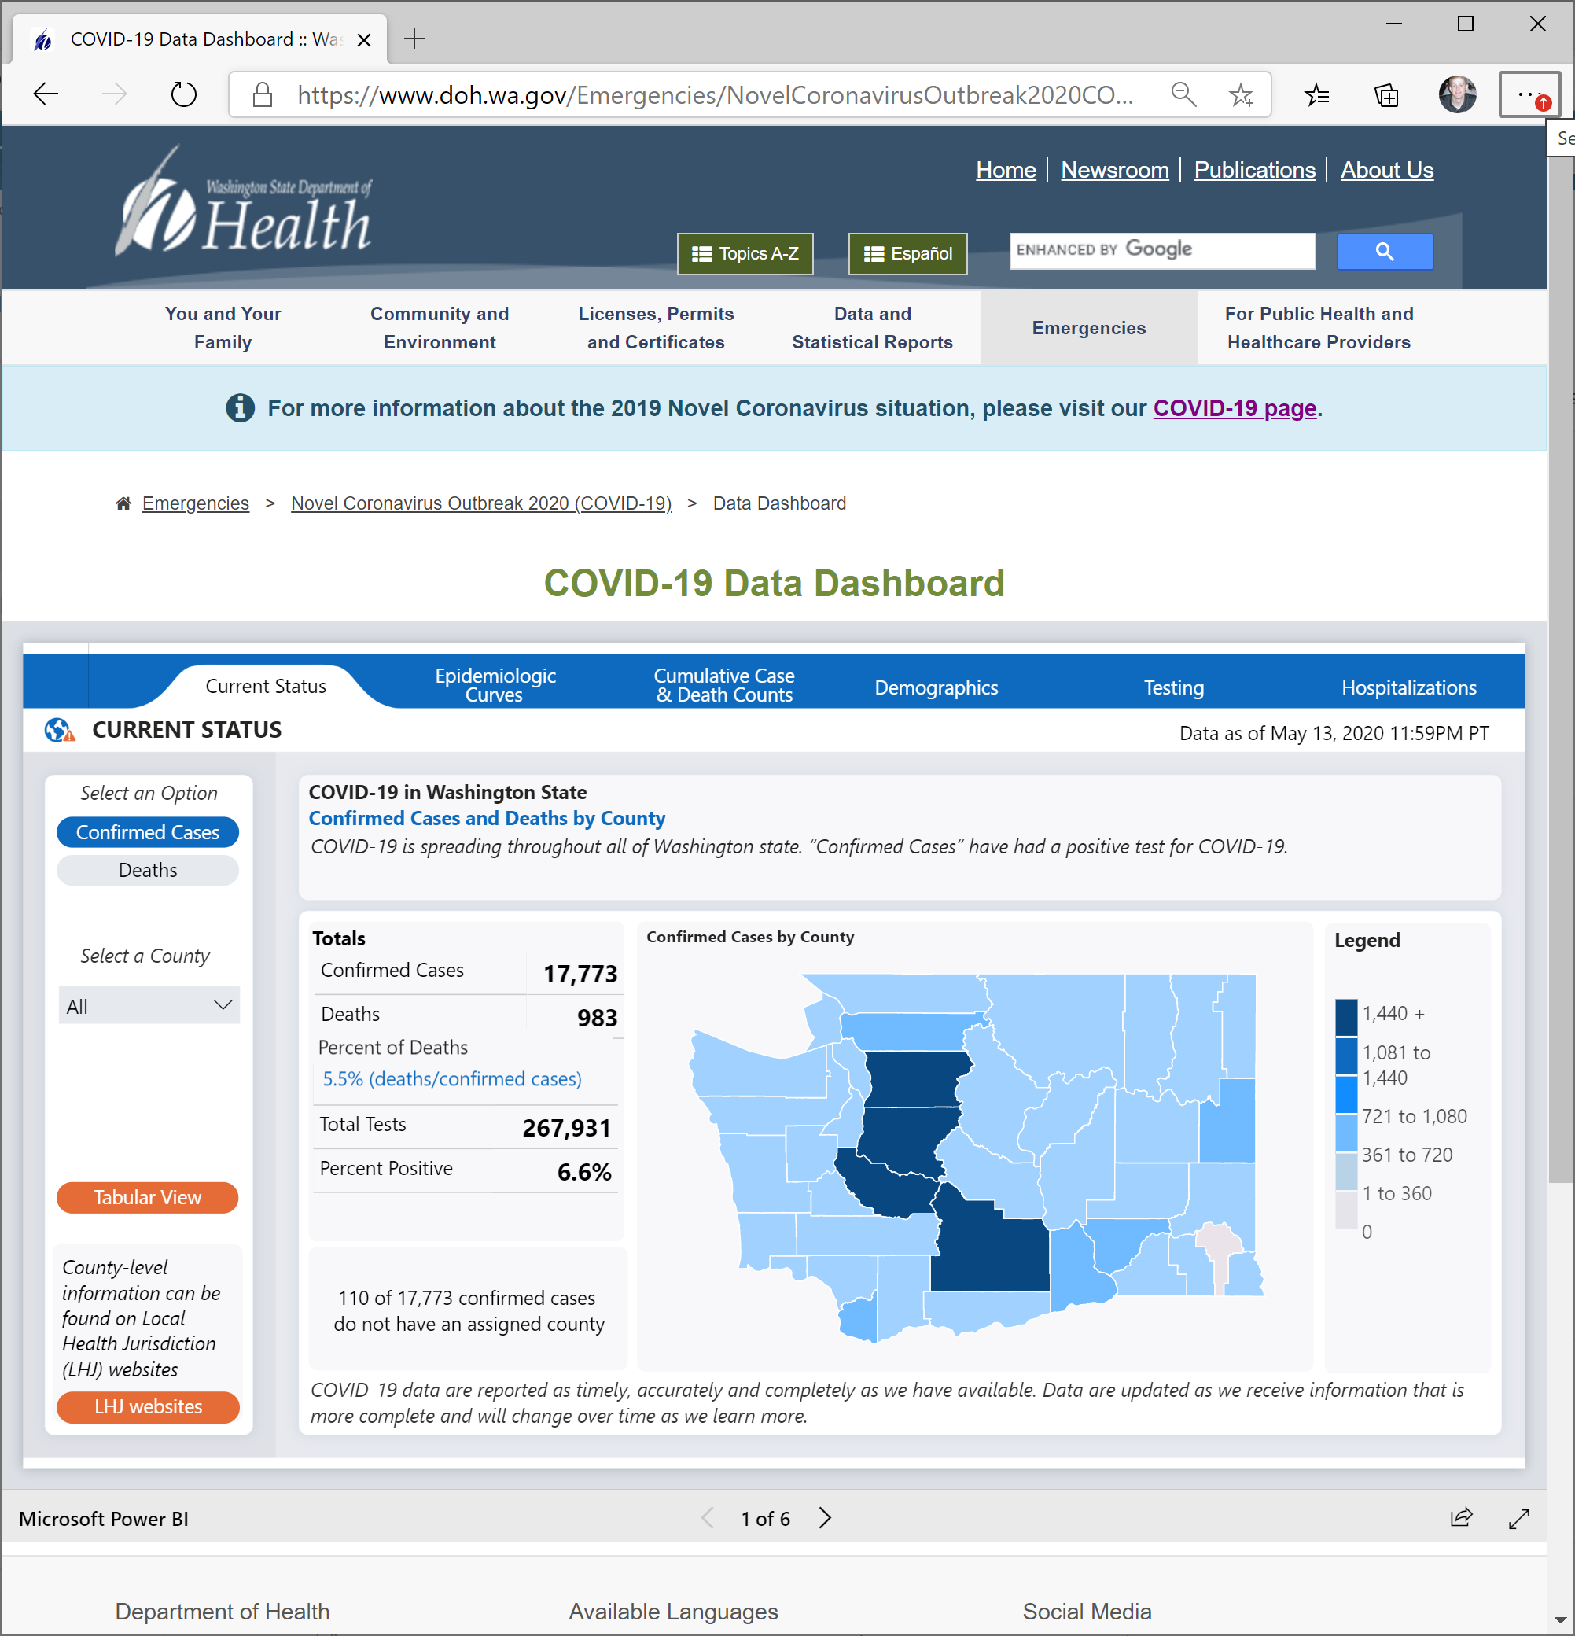

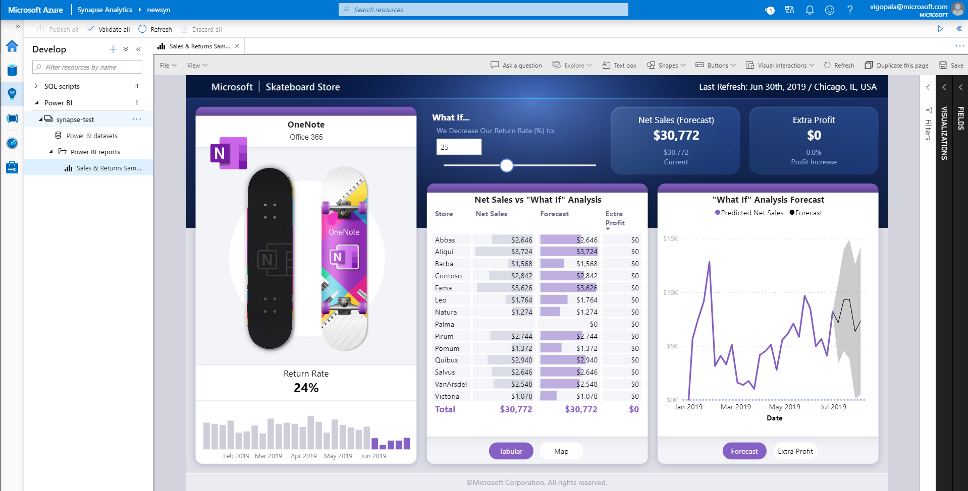


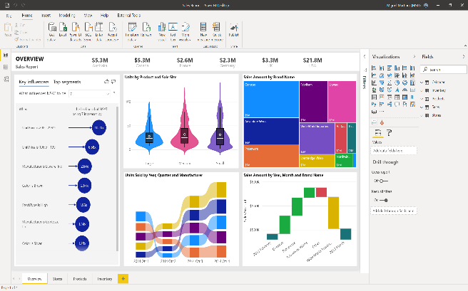
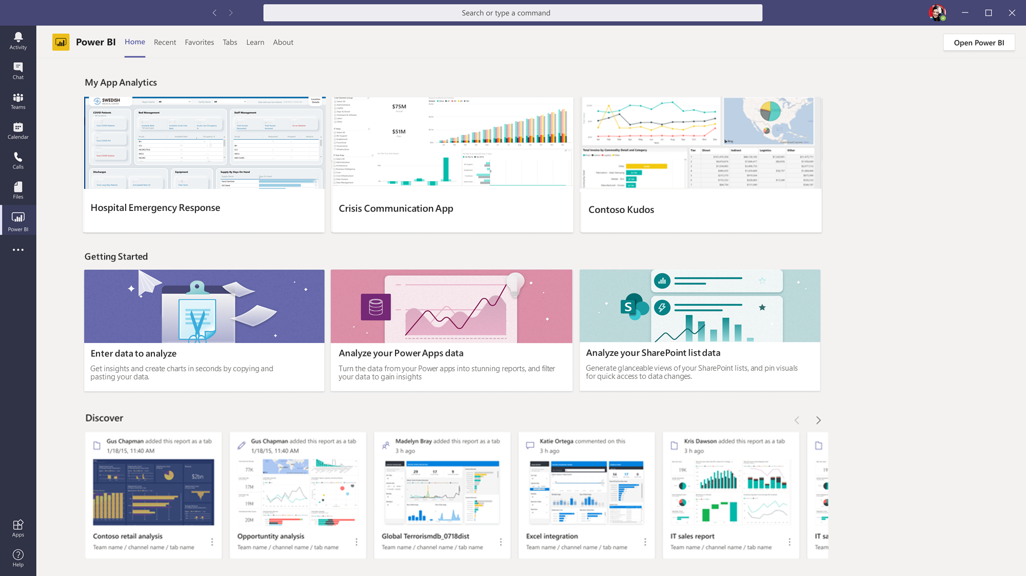
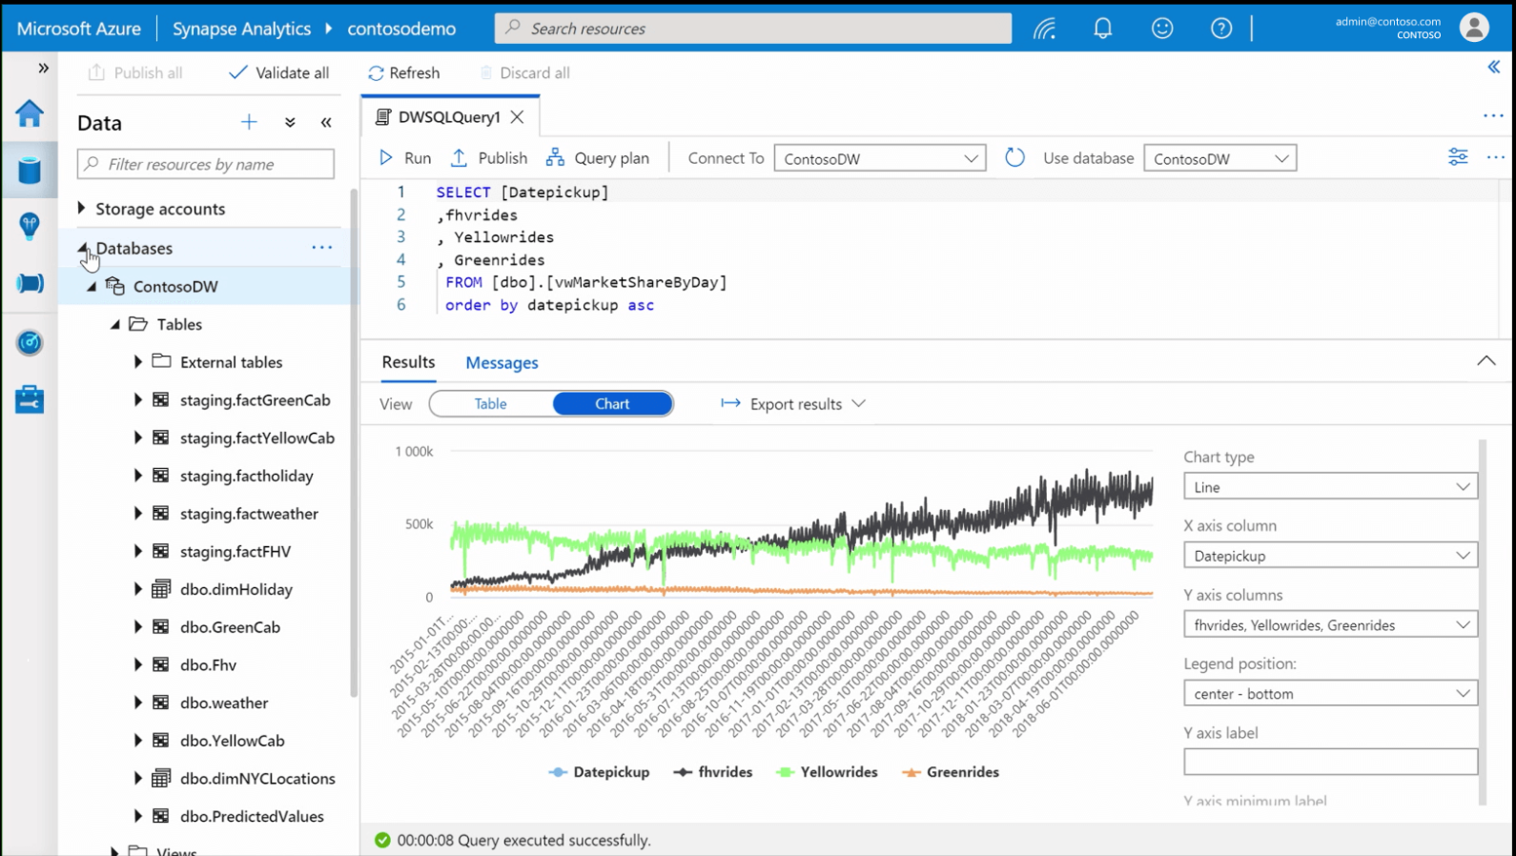

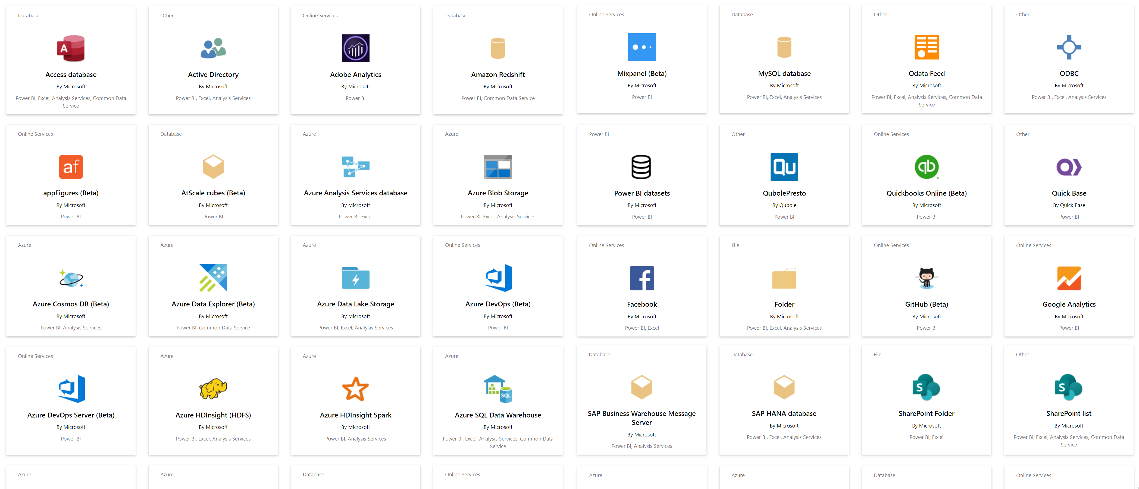
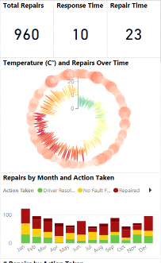

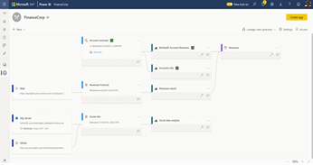
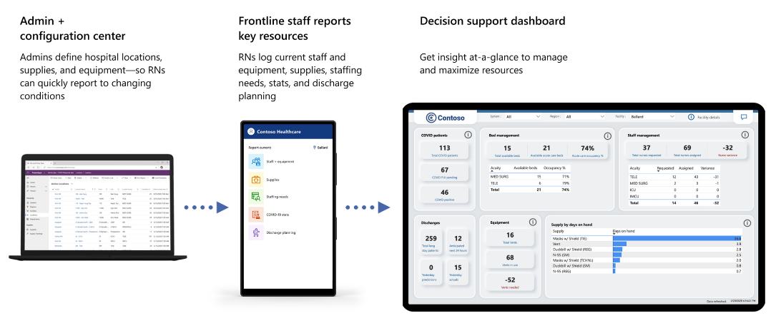
Power BI
All Data
For Everyone
For Every Decision
Break down data silos and enrich your data with intelligence
Create rich-interactive data experiences with AI infused insights
Integrate trusted and secure BI into the fabric of your organization and apps
Power BI drives a data culture for everyone and every decision
© 2021 Microsoft All rights reserved.

Slide 10
Module 1 Getting and Shaping the Data

Slide 11
Module 1 Objectives
Understand what is meant by data model in the context of Power BI
Understand the consequences of data model design decisions
Understand consequences of Power BI’s data type handling
Understand data connection options
© 2021 Microsoft All rights reserved.

Slide 12
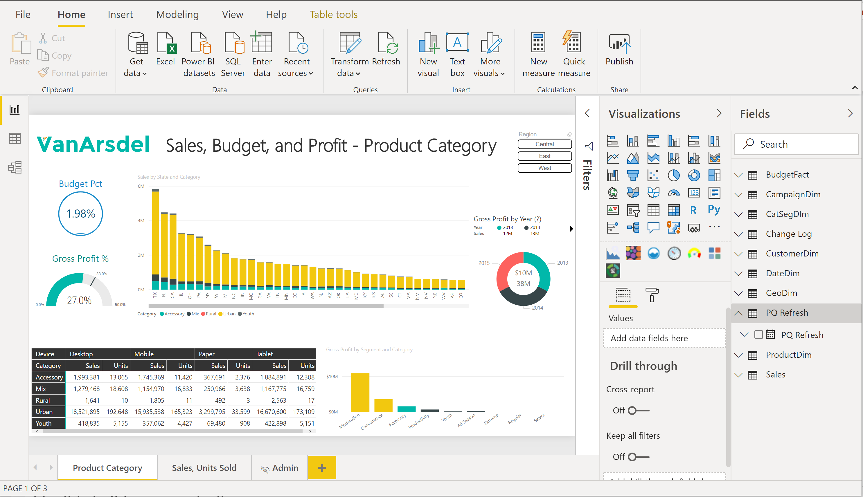

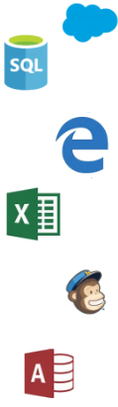
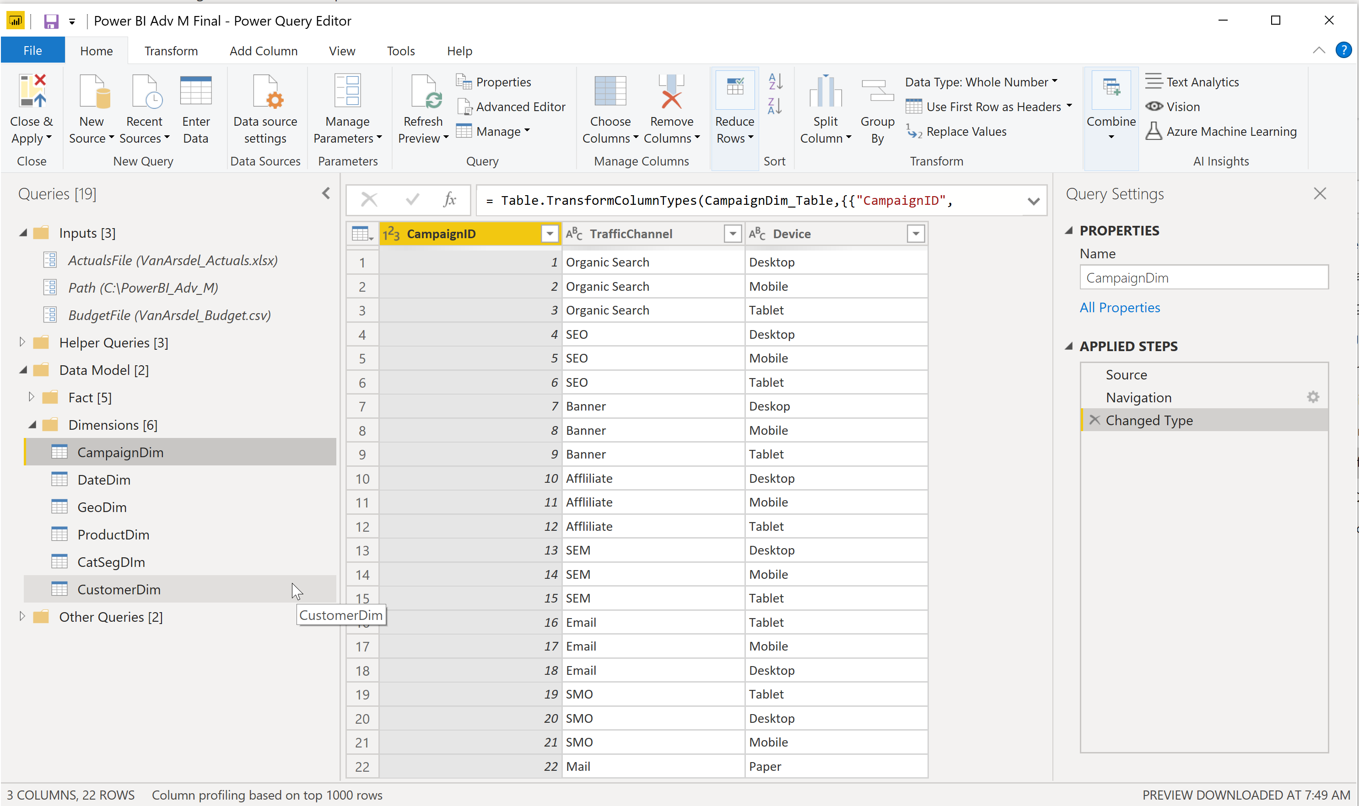


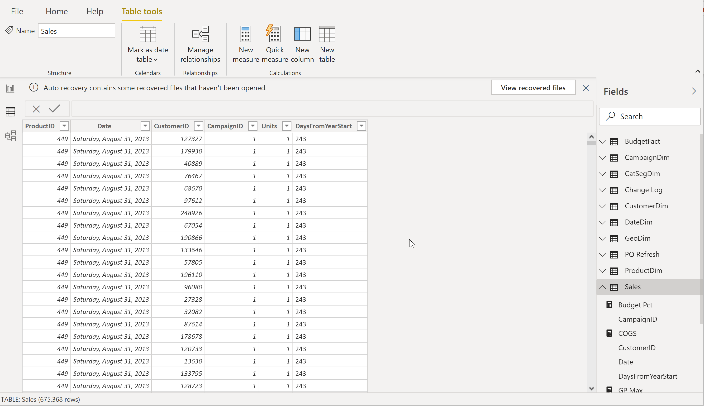

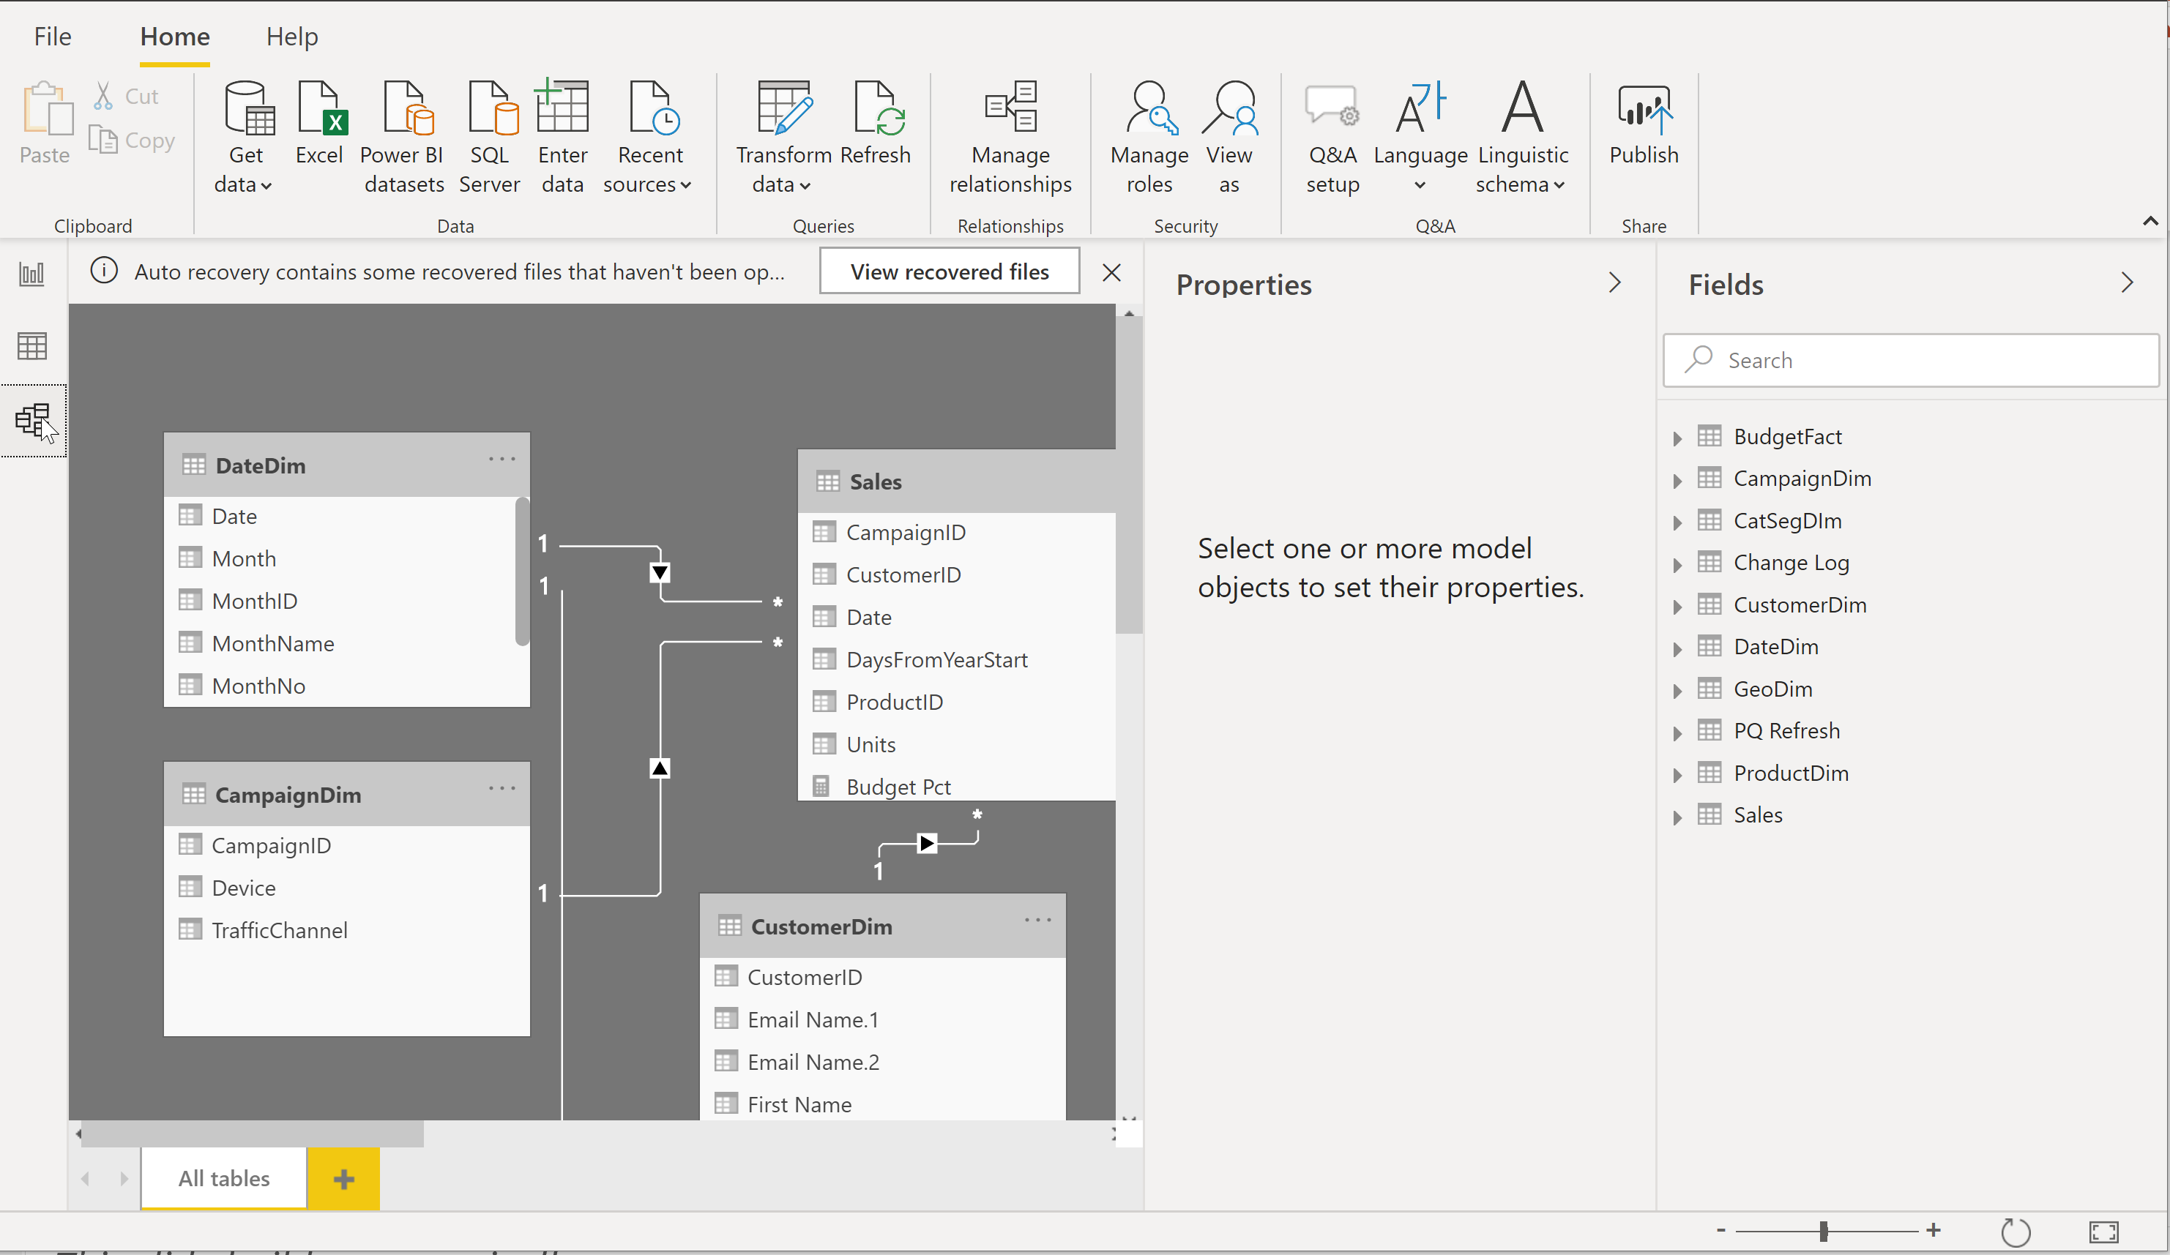

Power BI Desktop Workflow
Data Sources
Power BI Desktop file (.PBIX)
Report
Create visuals
Close & Apply
Close: Closes Query Editor
Apply: Loads data from sources to Data Model
Data
View tables
Query Editor
Data Source Connections
Data Transformations
(Prep data for Data Model)
Relationships
See how tables relate to each other
© 2021 Microsoft All rights reserved.

Slide 13
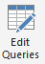

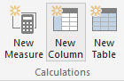
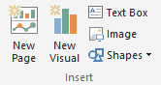
Phases in Building a Power BI Desktop File
Power BI Desktop Files
“Get Data” Phase
Model Creation Phase
Model
Enhancement
Phase
Visual
Building Phase
Compress data, auto detect relationships
(Automatically Detected)
Add calculated columns, measures, add missing relationships
Create query in “M”
Evaluate measures and build each visual
© 2021 Microsoft All rights reserved.

Slide 14
Intro to Parameters
A parameter serves as a way to easily store and manage a value that can be reused.
Parameters give you the flexibility to dynamically change the output of your queries depending on their value, and can be used for:
Changing the argument values for particular transforms and data source functions
Inputs in custom functions

Slide 15
Creating Parameters
Power Query provides two easy ways to create parameters:
From an existing query—You can easily right-click a query whose value is a simple non-structured constant such as, but not limited to, a date, text, or number, and select Convert to Parameter
Using the Manage Parameters window—You can select the New Parameter option from the dropdown menu of Manage Parameters in the Home tab

Slide 16
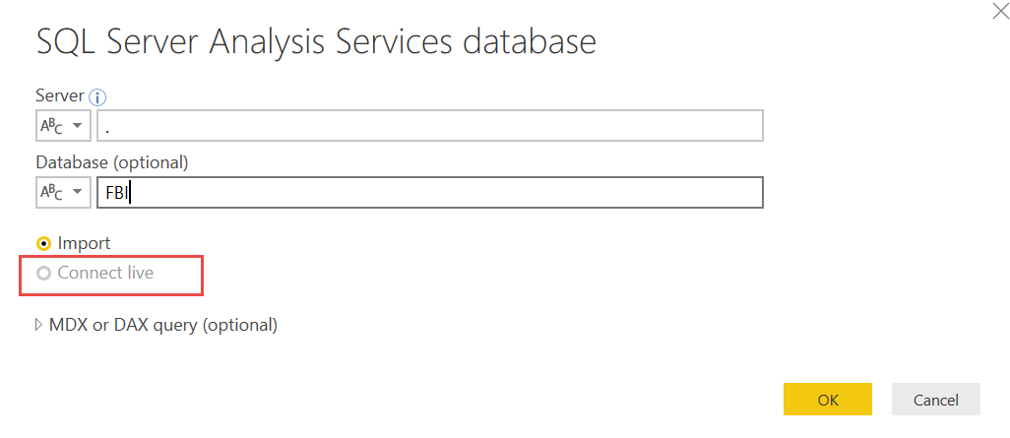
Getting the data - Data Connection
Import data – Connect to a data source and import directly to the .pbix file
Live connect to multidimensional or tabular
direct query to a database
Both connections can be used from various data sources
Will be used in this course
© 2021 Microsoft All rights reserved.

Slide 17
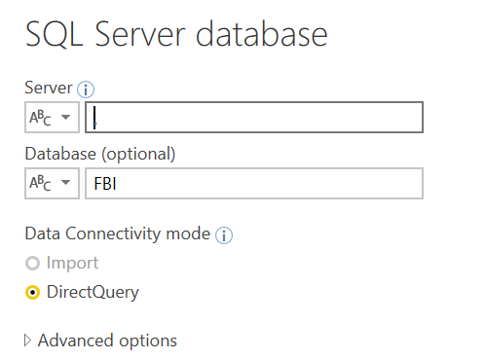
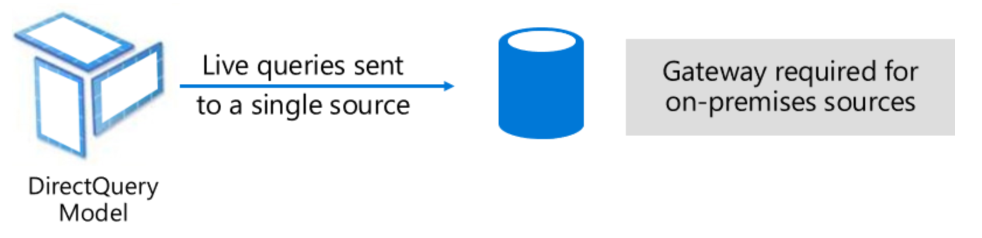
Connection: Direct Query to Relational Source
Direct query to SQL or other relational source
on premises or Azure
© 2021 Microsoft All rights reserved.

Slide 18
Composite Model
Allows a report to have two or more data connections from different source groups, such as one or more DirectQuery connections and an import connection, two or more DirectQuery connections, or any combination
Combines data from one or more DirectQuery sources.
Combines data from DirectQuery sources and imports data.
© 2021 Microsoft All rights reserved.

Slide 19
Direct Query with Large Data Sets
Mode used when Power BI model accessing a SQL Server Analysis Services (SSAS) data model
Can be a server (IaaS) or Azure Analysis Services (PaaS)
When is it appropriate
Organization has already invested significantly in SSAS, have mature models
High level of control needed around partitions, data refresh, query scale-out and workload splitting
Granular auditing, monitoring and diagnostics
Integration with CI/CD or similar automation pipelines
Models can’t fit in Premium (P3+ models up to 10GB v. no overall model size limit in SSAS)
Considerations
Strategically we will be bringing those features to Premium over time
© 2021 Microsoft All rights reserved.

Slide 20
Choosing Storage Mode: Import vs Direct Query
Import is your first choice (all in memory = best speed, no DAX limits)
When is it inappropriate
Extremely large data volumes
Need near real-time access to data from source
Considerable existing investment in external DW or OLAP (modelled, conformed, cleaned, calcs defined etc). SSAS MD, SAP HANA and BW are common.
Regulatory and data sovereignty requirements
Considerations
How much source data, how compressible? Rule of thumb is 5x-10x
Is Premium an option? (larger datasets supported there)
Will blended architecture suffice? (Composite models, Aggregations for summary data)
Some limits on DAX in DirectQuery mode (e.g. time intelligence)
© 2021 Microsoft All rights reserved.

Slide 21
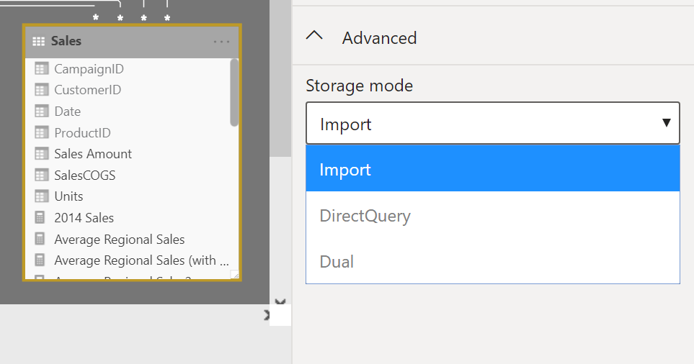
Which Storage mode table in my model are using?
Import Mode - Import data into Power BI (creates a copy of the data)
Queries can be fulfilled from cached data Example: Excel File
Direct Query Mode - DirectQuery to SQL, Power BI Datasets & Azure
Executing on demand queries to the data source
Example: Analysis Services - Live Connect to SQL Analysis Services (SSAS) - Tabular
Dual – can act as either cached or not cached, depending on query context
Will be used in this course
© 2021 Microsoft All rights reserved.

Slide 22
Demo 1a Introduction – Introduction, shaping the data

Slide 23
Columnar Database
Row Based Database
PBI - Columnar Database
First Name | Last Name | Sales
John | Smith | $10
Jane | Doe | $25
Hardy | B | $35
First Name | Last Name | Sales
John | Smith | $10
Jane | Doe | $25
Hardy | B | $35
Stores each row separately (like a separate file)
Retrieving multiple columns from a single row is fast
Retrieving multiple rows from a single column is slower
Stores each column separately (like a separate file)
Retrieving multiple columns from a single row is slow
Retrieving multiple rows from a single column is faster
Columnar databases are well suited for analytics
© 2021 Microsoft All rights reserved.

Slide 24
In-Memory Database
PBI – In-Memory Database
Data stored in RAM (in memory)
RAM is all electronic – Read/Write is fast
Laptops have smaller RAM space (~8GB)
Power BI compresses data to conserve space in RAM
© 2021 Microsoft All rights reserved.

Slide 25
How Power BI Compresses Data – Dictionary Encoding
Compressing Data – Dictionary Encoding
Sale Id | Color | Sales Amount
390a30e0-dc37 | Red | $10
390a30e1-dc37 | Green | $25
390a30e2-dc37 | Red | $35
390a30e3-dc37 | Red | $15
390a30e4-dc37 | Red | $25
390a30e5-dc37 | Green | $30
390a30e6-dc37 | Blue | $10
390a30e7-dc37 | Blue | $12
390a30e8-dc37 | Blue | $15
390a57f0-dc37 | Blue | $18
390a57f1-dc37 | Green | $25
Red = 1 Green = 2 Blue = 3
Create a Dictionary to create an integer value for text string
Storing 1,2,3 instead of “Red”, “Green”, “Blue” saves memory
Dictionary encoding is powerful when there are few unique values in a column
Ex. Color column – Good for dictionary encoding
Ex. Sale ID – Bad for dictionary encoding
© 2021 Microsoft All rights reserved.

Slide 26
How Power BI Compresses Data – Run Length Encoding
Compressing Data – Run Length Encoding
Sale Id | Color | Sales Amount
390a30e0-dc37 | Red | $10
390a30e1-dc37 | Green | $25
390a30e2-dc37 | Red | $35
390a30e3-dc37 | Red | $15
390a30e4-dc37 | Red | $25
390a30e5-dc37 | Green | $30
390a30e6-dc37 | Blue | $10
390a30e7-dc37 | Blue | $12
390a30e8-dc37 | Blue | $15
390a57f0-dc37 | Blue | $18
390a57f1-dc37 | Green | $25
1
2
1
1
1
2
3
3
3
3
2
Run Length Encoding in Power BI
Instead of storing - 1, 2, 1, 1, 1, 2, 3, 3, 3, 3, 2
It Stores:
Run length encoding is very powerful when data is sorted well and has few unique values
Where Red = 1 Green = 2 Blue = 3
Subject | Count
1 | 4
2 | 3
3 | 4
© 2021 Microsoft All rights reserved.

Slide 27
Practical Example of Compression
Compression
Dashboard in a Day Class Data
DIAD Complete Data Model
Sales Fact | 420.0 MB
Dimensions | 4.4 MB
Int’l Sales | 32.4 MB
Total Data | 456.8 MB
Data Model | 59.4 MB
Almost 8X Compression!
Queries ONLY – No Data Loaded
Query Metadata | 113 KB
© 2021 Microsoft All rights reserved.

Slide 28
Phases in Building a Power BI Desktop File
Power BI Desktop Files
“Get Data” Phase
Model Creation Phase
Model
Enhancement
Phase
Visual
Building Phase
Compress data, auto detect relationships
(Automatically Detected)
Add calculated columns, measures, add missing relationships
Create query in “M”
Evaluate measures and build each visual
© 2021 Microsoft All rights reserved.

Slide 29
Data Types
Numeric Data Types
Whole Number
Decimal Number
Fixed Decimal Number (Floating point stored as integer)
Boolean
Date/Time Data Types
Date – Internally stored as an integer
Time – Internally stored as a fraction between 0 and 1
Date Time
Other Data Types
Text
Any – Avoid
Set your Data Types in the Query Editor
Set your Data Formats ($ %, etc) in the Data Model
Pro Tip: Data type is different from data format
© 2021 Microsoft All rights reserved.

Slide 30
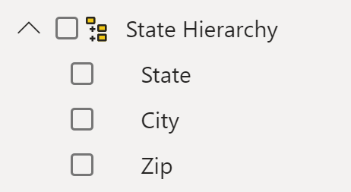
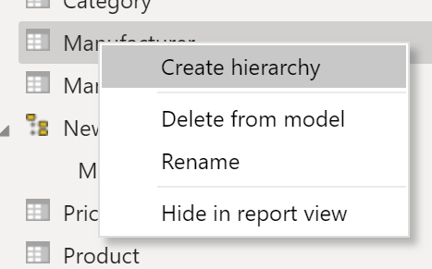
Hierarchies
Power BI generates date hierarchies when dates are added to visuals, this allows the end user to drill from Year, Quarter, Month & Day.
Users can also create custom hierarchies:
Option 1: right side of the screen, click on table by adding a lower-level field onto the parent in the model view
Option 2: In modeling view click on a column and select create hierarchy
© 2021 Microsoft All rights reserved.

Slide 31
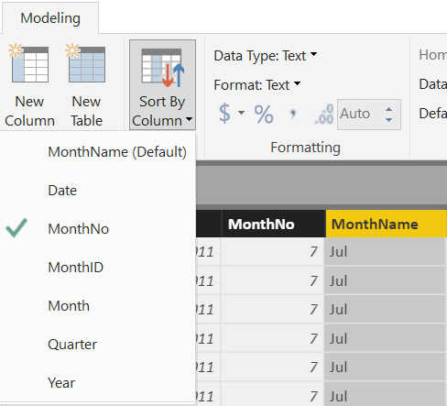
Sort By Column
Enables sorting one text field by another (numeric) field
Both columns must have the same number of distinct values
© 2021 Microsoft All rights reserved.

Slide 32
Aggregations
Using aggregations in Power BI enables interactive analysis over big data.
Advantages of aggregations are:
Query performance over big data
Data refresh optimization
Achieve balanced architectures
© 2021 Microsoft All rights reserved.

Slide 33
Demo 1b Data Shaping

Slide 34
Module 1 Lab:
Lab 1a – Import Data
Lab 1b – Create Parameter

Slide 35
Module 2 Data Modeling

Slide 36
Module 2 Objectives
Understand basic data modeling
Understand basic data model types
Explore dimension tables and fact tables
Explore data connections
© 2021 Microsoft All rights reserved.

Slide 37
What is a Data Model
A Power BI Data Model is a collection of tables with relationships which enable your business users to easily understand and explore their data to get business insights.
Why is it important to have a Good Data model?
Improves understandability of the data
Increases performance of dependent processes and systems
Increases resilience to change
© 2021 Microsoft All rights reserved.

Slide 38
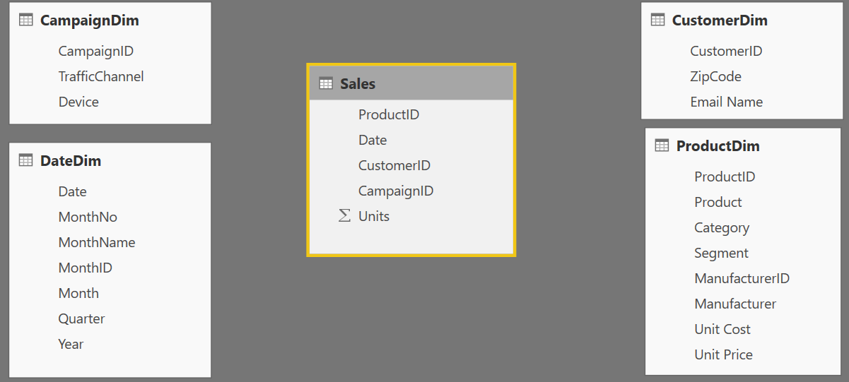
Basic Data Modeling
Components of a data model – Fact Table
Fact Table
Contains (numerical) values or items to be aggregated of a business process Examples:
Transactions
Sales Revenue
Units
Cost
Measures are usually sliceable.
Examples:
By Month, By Customer
Fact
Table
© 2021 Microsoft All rights reserved.

Slide 39
Basic Data Modeling
Components of a data model – Dim Table
Dim Table
A Dim (or Dimension) table contains descriptive attributes that define how a fact should roll up.
Examples: By month,
By Customer, By Geo
Dim
Tables
Dim
Tables
© 2021 Microsoft All rights reserved.

Slide 40

Basic Data Modeling
Components of a data model - Relationships
Relationships
Connection between two tables (usually fact & dim tables) using matching columns from each
Three types of Relationships
1 to Many
1 to 1
Many to Many
(with or without a bridge table)
Relationships
Relationships
© 2021 Microsoft All rights reserved.

Slide 41
Basic Data Modeling
Data Model Brings Facts and Dimensions Together
Type of Data Models
Star Schema
Snowflake Schema
Flat or Denormalized
Note: Those are the most common model types used by Power BI other models can be supported.
© 2021 Microsoft All rights reserved.

Slide 42
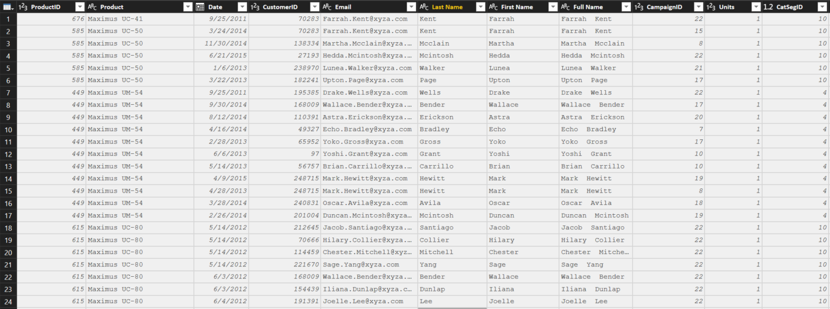
Basic Data Modeling
Flat or Denormalized schema
All attributes for a model exist in a single table
Highly inefficient
Model has extra copies of data > slow performance
Size of a flat table can blow up really quickly as data model becomes complex
© 2021 Microsoft All rights reserved.

Slide 43
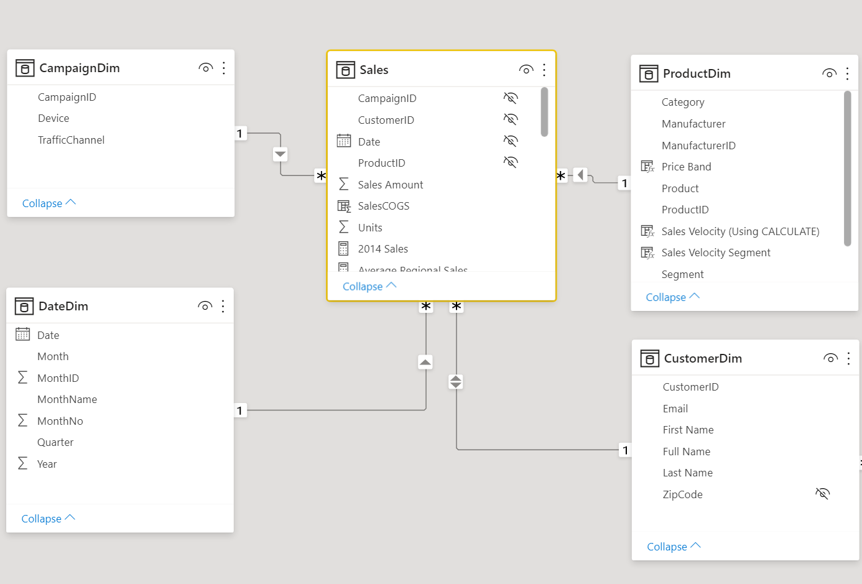
Basic Data Modeling Star Schema
1
Many
1
Fact table in the middle
Surrounded by Dim tables
Looks like a ‘Star’
Fact table is the “Many” side of the (one to many) relationship
The table names should be consistent and meaningful
1
© 2021 Microsoft All rights reserved.

Slide 44
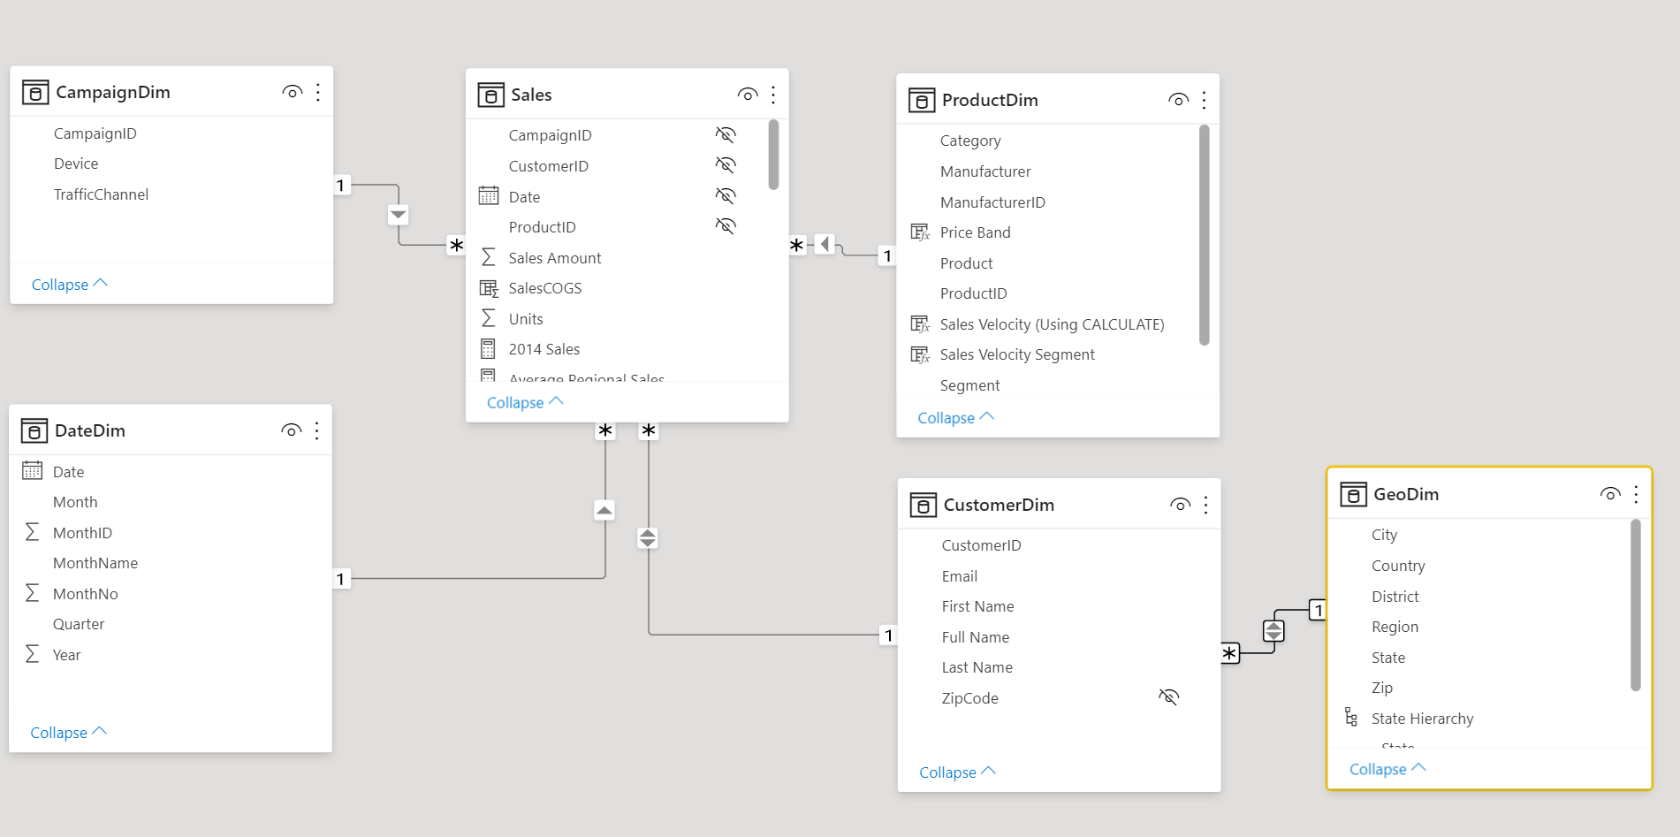
Basic Data Modeling Snowflake Schema
Snowflake Schema
Center is a Star schema
Fact table in middle
Surrounded by Dim tables
Dims “snowflake” to other Dims
If you have many, it looks like a ‘Snowflake’
Dim or Fact tables can be the “Many” side of the relationship
Dims
Facts
Dims
Flake
© 2021 Microsoft All rights reserved.

Slide 45
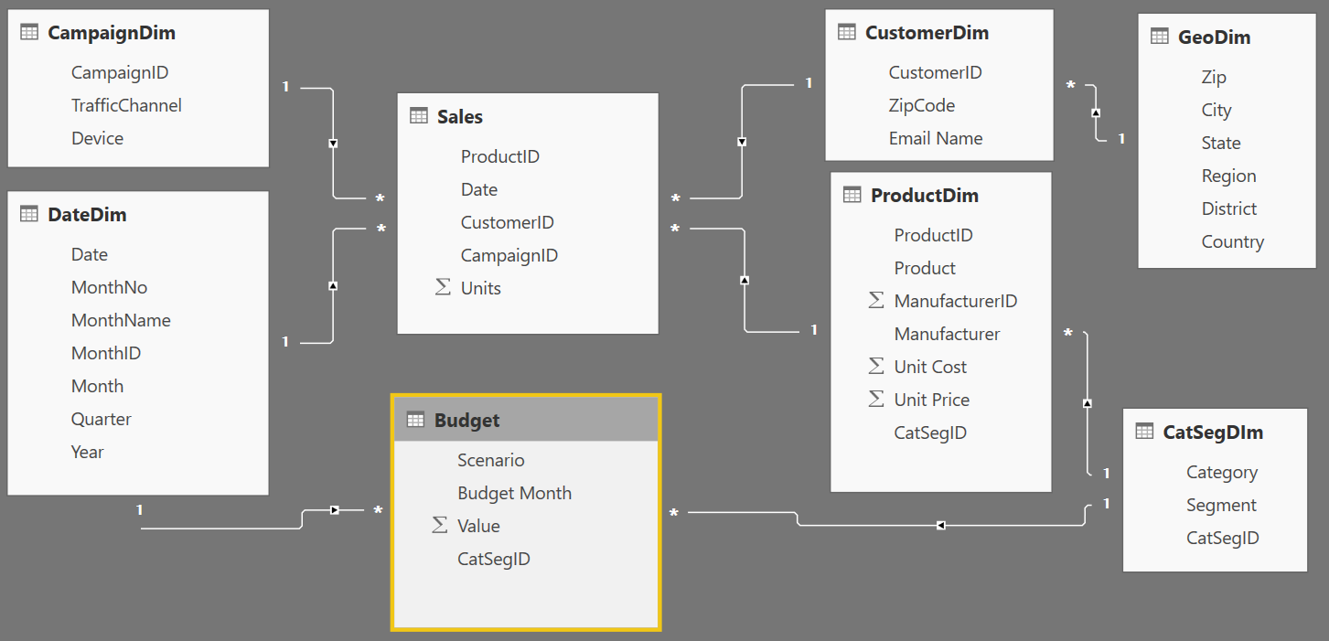
Basic Data Modeling – Multiple Fact Tables
Granularity & Multiple Fact
Grain (granularity) measures the level of detail in a table
Example:
One row per order or per Item
Daily or monthly date grain
If your facts have very different granularities, split them into multiple fact tables & connect them to shared dimensions at the lowest common granularity.
SalesFact (Daily by Product)
BudgetFact (Monthly by Product Category & Product Segment)
© 2021 Microsoft All rights reserved.

Slide 46
Demo 2: Data Modeling

Slide 47
Module 2 Lab: Lab 2a – Create CatSegDim Dimension Lab 2b – Update Dimension Lab 2c – Create Customer Dimension Lab 2d – Create Budget Fact Table

Slide 48
Module 2 Knowledge Check https://aka.ms/PBIModShapCheck2

Slide 49
Module 2 Knowledge Check Questions
What is one of the advantages to using a star schema?
You will lower the amount of memory needed
All attributes exist in a single table
It is highly inefficient
Why is it important to have a good data model?
Improves understandability of the data
Decreases resilience to change
Processes may take longer
What table should measures exist in?
Dimension table
Fact table
Date table
© 2021 Microsoft All rights reserved.

Slide 50
Module 3 Introduction to M

Slide 51
Module 3 Objectives
Get introduced to M
Understand key components and syntax
© 2021 Microsoft All rights reserved.

Slide 52








Why M?
M has amazing capabilities to transform data to optimize it for the data model
© 2021 Microsoft All rights reserved.

Slide 53
What is M? (Power Query M)
The Power Query Formula Language is a powerful query language optimized for building queries that mashup data. It's a functional, case sensitive language.
For computer language theorists: Power Query is a mostly pure, higher-order, dynamically typed, partially lazy, functional language. You can create a variety of data mashup queries from simple to advanced scenarios.
(Source: MSDN)
© 2021 Microsoft All rights reserved.

Slide 54
How do I use M?
Three ways to write M
Click and Adjust
Custom Code
Use the Ribbon
Simple
Advanced
© 2021 Microsoft All rights reserved.

Slide 55
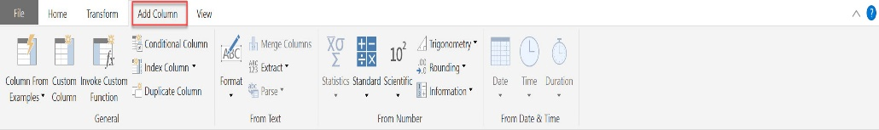
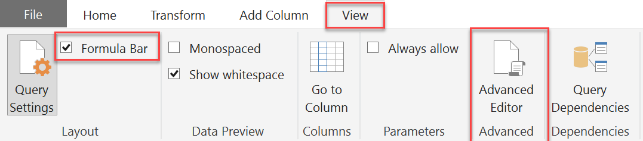
Key Concepts of M Syntax
M is the key to data transformation in Power BI
Many transformations are just a click away on the Ribbons
Turn on Formula Bar to see M syntax generated by clicks
View full syntax in Advanced Editor
M is CaSe SeNsItIvE!
© 2021 Microsoft All rights reserved.

Slide 56
Key Concepts of M
M Values | M Functions | M Syntax
Used to create new artifacts and literals | Foundation of transformations | How your queries are structured
#date(2016,01,01) #date(YYYY,MM,DD) #datetime(2016,02,26, 09,15,00) #datetime(YYYY,MM,DD,HH,MM,SS) #table({"X","Y"},{{0,1},{1,0}}) [a = 100, b = 200] | Syntax: Object.Action() Objects: Table, List, Record, Text, Number, Date, etc. Actions (Camel Case): ToList, DayOfWeek, ToNumber, FromText, etc. Examples: Table.SelectRows, Date.FromText, Number.FromText | let in each if then else true false error and or not try otherwise as is meta section shared type
© 2021 Microsoft All rights reserved.

Slide 57
Primitive Type Values
Type | Example |  | Type | Example
binary | #binary("AQID") |  | list | {“foo”, “bar”, 10}
date | #date(2021,7,10) |  | record | [a = 10, b = 20]
time | #time(18,30,0) |  | type | Value.Type(10)
datetime | #datetime(2021,7,10,18,30,0)
datetimezone | #datetimezone(2021,7,10,18,30,0,0,6)
duration | #duration(1,0,0,0)
logical | true and false
null | null
number | 0, 1, -1, 1.5
text | “hello, world”
© 2021 Microsoft All rights reserved.

Slide 58
Abstract Type Values
Type | Example
table | #table({“Animal”,”Color”}, {{“Cat”,”Black”},{“Dog”,”Brown”}})
function | let foobar = (param) as any => foobar = param in foobar
any
none
© 2021 Microsoft All rights reserved.

Slide 59
Text Functions
M Function Syntax | Excel Syntax | M Output
Text.Start([MyColumn], 3) | LEFT([MyColumn], 3) | ABC
Text.End([MyColumn], 4) | RIGHT([MyColumn], 4) | 5xyz
Text.Range([MyColumn], 4, 3) * | MID([MyColumn], 5, 3) ** | 234
Text.Range([MyColumn], 4) * | MID([MyColumn], 5) ** | 2345xyz
Text.StartsWith ([MyColumn], "abc") | IF(LEFT([MyColumn], 3)=“abc” , TRUE(), FALSE()) | FALSE (Excel -> TRUE)
Text.StartsWith ([MyColumn], “ABC") | IF(LEFT([MyColumn], 3)=“ABC”, TRUE(), FALSE()) | TRUE
Text.Length([MyColumn]) | LEN([MyColumn]) | 11
Text.Contains ([MyColumn], "123") | IF(ISNUMBER(SEARCH(“123", [MyColumn])),TRUE(), FALSE()) ** | TRUE
Text.PositionOf ([MyColumn], "5" ) * | SEARCH(“5", [MyColumn]) ** | 7 (Excel -> 8)
© 2021 Microsoft All rights reserved.

Slide 60
Text Functions
M
Excel
Position
0 1 2 3 4 5 6 7 8 9 10
1 2 3 4 5 6 7 8 9 10 11
My Column
A B C 1 2 3 4 5 x y z
A B C 1 2 3 4 5 x y z
Return "ABC"
Text.Start([MyColumn], 3)
LEFT([MyColumn], 3)
Return "234"
Text.Range([MyColumn],
4
, 3)
MID([MyColumn,
5
, 3)
Find position of "5"
PositionOf([MyColumn], "5") =
7
SEARCH("5", [MyColumn]) =
8
© 2021 Microsoft All rights reserved.

Slide 61
Syntax
let Source = in
let Source = “Hello, World!” in
let Source = “Hello, World!” in Source
© 2021 Microsoft All rights reserved.

Slide 62
if….then….else
Simple example (1 each of if, then & else)
=if [Column2] = "Key" then [Column2] else “Other”
Basic Syntax: if <test if true> then <result if true> else <result if false>
if’s can be chained or nested
No parentheses () are required, except
When if test or results have multiple conditions:
(condition 1 and condition 2)
(condition 1 or condition 2)
(condition 1 or (condition 2 and condition 3))
If multiple if’s are used ensure you have the same number of “if”, “then”, “else”
Chained example (3 each of if, then & else)
=if Text.EndsWith([Column2],"Key") then [Column2] else
if [Column2] = "TotalCost" then "Cost $" else
if [Column2] = "SalesQuantity" then "Sales #" else null
Nested example (3 each of if, then & else)
=if Text.EndsWith([Column2],"Key") then
if [Column2] = "TotalCost" then "Cost $" else
if [Column2] = "SalesQuantity" then "Sales #" else null
else “Item #"
Multiple conditions example (1 each of if, then & else)
=if (Text.Length([Column2]) = 3 or Text.Length([Column2]) = 2 )
then true else false
© 2021 Microsoft All rights reserved.

Slide 63
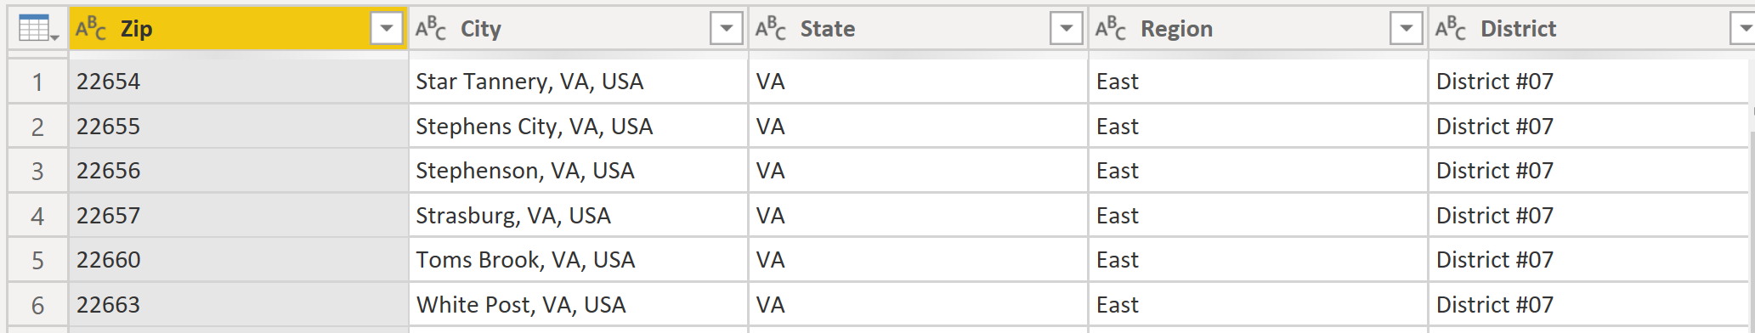
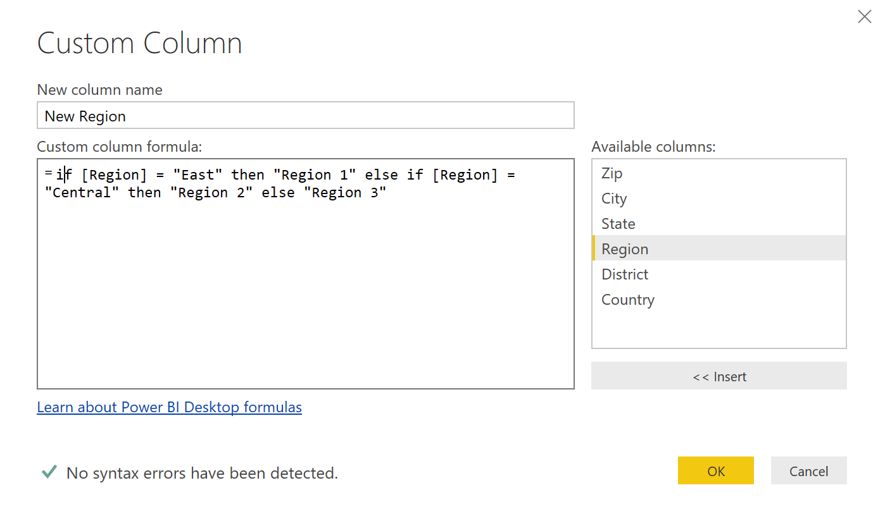
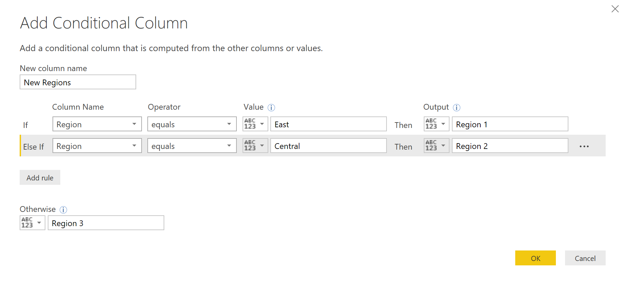
if….then….else Using Conditional and Custom Column
Whether you use Conditional Column or Custom Column, the results are the same
1. How it reads in the formula bar when using the Conditional Column format
2. When using the Custom Column format
© 2021 Microsoft All rights reserved.

Slide 64
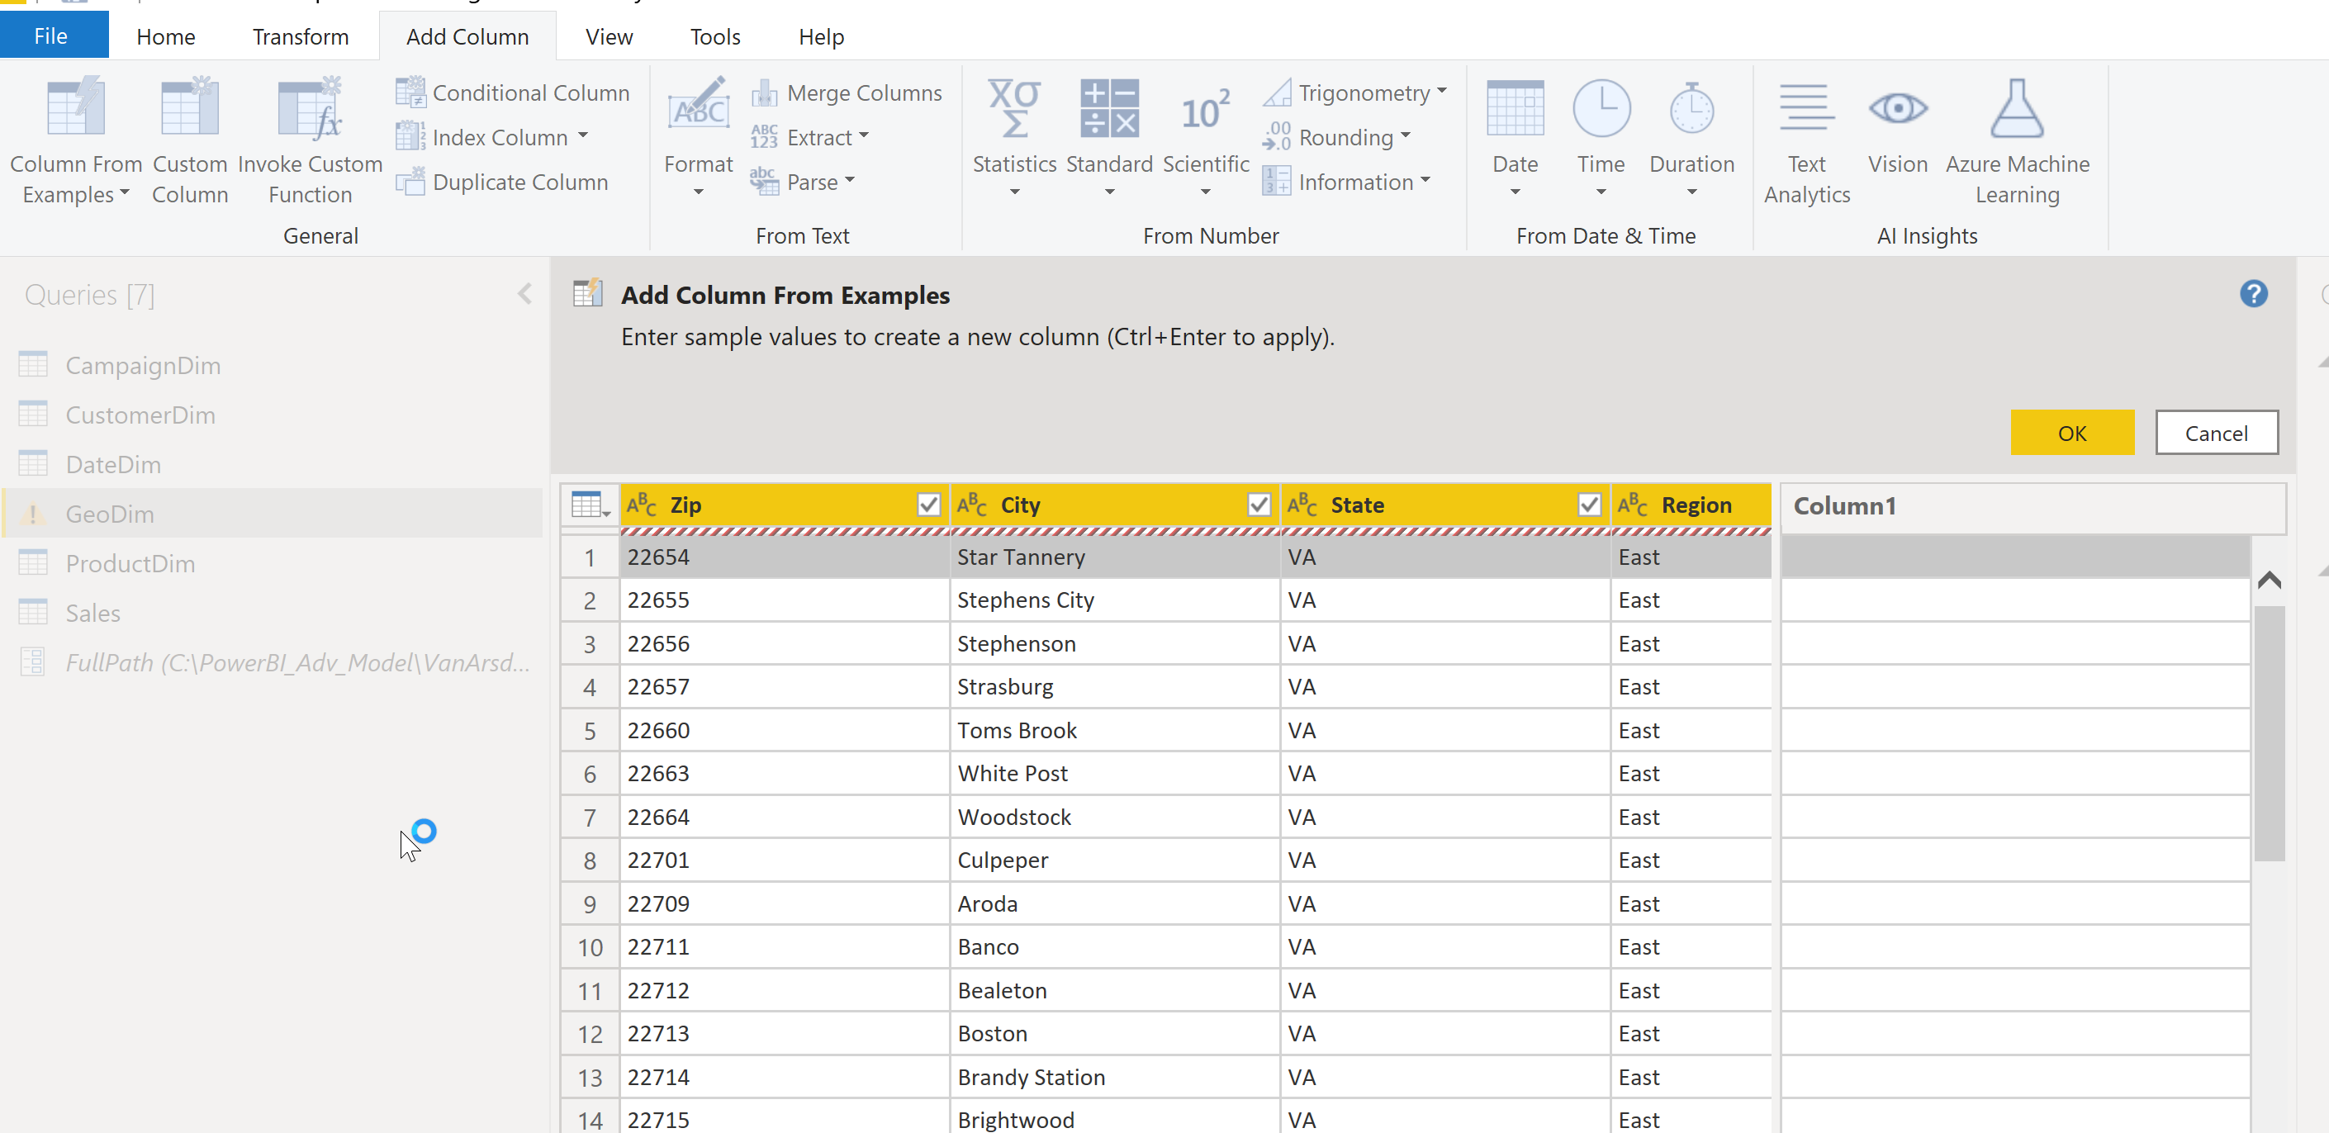
if….then….else Using Column From Examples
You can use Column From Examples to create if else logic
© 2021 Microsoft All rights reserved.

Slide 65
Demo 3 Power Query M

Slide 66
Module 3 Lab: Lab 3 – Create relationships between tables

Slide 67
Module 3 Knowledge Check https://aka.ms/PBIModShapCheck3

Slide 68
Module 3 Knowledge Check Questions
What is M used for?
To create dimension attributes
To build queries that mashup data
To separate facts and dimensions
Which way can you NOT use M?
Custom code
Using the ribbon
Importing a table
What is one rule of using M?
The code must be in bold
It is case sensitive
You cannot use if then else statements
© 2021 Microsoft All rights reserved.

Slide 69
Module 4 Understand Logic Operands

Slide 70
Module 4 Objectives
Understand Transformations
Understand Join operation
© 2021 Microsoft All rights reserved.

Slide 71
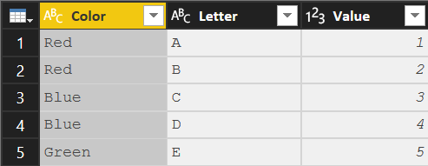
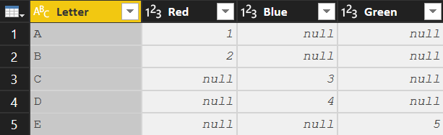
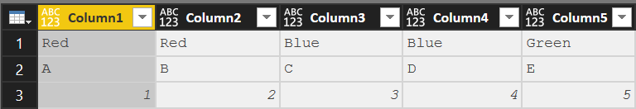
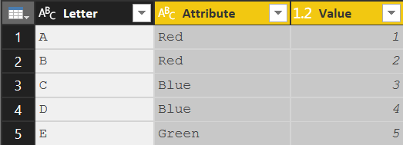
Key Transformations
Transpose
Convert Rows to Columns and Columns to Rows
Syntax: Table.Transpose(Previous)
Column headers are lost
To transpose column headers, demote them to data prior to transpose
Pivot Column
Convert Selected column of values into Column Headers
Syntax:
Table.Pivot(Previous,List.Distinct(Previous[Color]), "Color", "Value", List.Sum)
The values in [Color] column are converted to headers
The values in the [Value] column are filled in where applicable
Unpivot Columns
Convert Selected Column Headers into a column of values
Syntax:
Table.UnpivotOtherColumns(Previous, {"Letter"}, "Attribute", "Value")
The unpivoted column headers become the column [Attribute]
The unpivoted values become the column [Value]
Note: Previous => Name of the previous step in the query
© 2021 Microsoft All rights reserved.

Slide 72
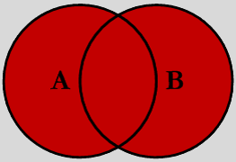
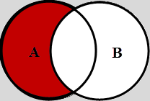
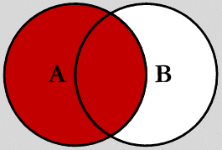

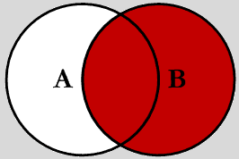
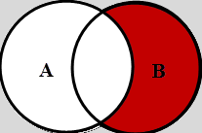
Join Kinds – Merge Types
Full Outer (JoinKind.FullOuter)
Shows all of the rows from both queries. Like SQL “Union All”
Left Outer (JoinKind.LeftOuter) Default for Merge
Shows all rows in 1st query (A) and “paints” attributes from second query (B) based on matches in joined column(s).
Left Anti (JoinKind.LeftAnti) Shows ONLY rows in 1st (A) query where there is NO MATCH to 2nd query (B) based on joined column(s)
Inner (JoinKind.Inner)
Limits the rows to ONLY those which Match on joined column(s)
Right Outer (JoinKind.RightOuter) Shows all rows in 2nd (B) query and “paints” attributes from 1st query (A) based on matches in joined column(s)
Right Anti (JoinKind.RightAnti) Shows ONLY rows in 2nd (B) query where there is NO MATCH to 1st query (A) based on joined column(s)
Note: One or Multiple columns can be used to create the join
© 2021 Microsoft All rights reserved.

Slide 73
Join Kinds – Other Combining Queries
Merge Combines attributes (columns) of two queries based on a joined columns(s)
Column(s) used for the join must be in both queries (can be one or more)
Both queries rerun with each execution
In Database terms, this is a JOIN
Append “Stack” records of two (or more) queries
Both (all) queries rerun with each execution
Like column headers must be named the same
Non-matching columns will be added to the right as extra colunns
Duplicate
Copies a query at a point in time (Save As)
Duplicate query can be modified independently without altering the original query
Executing the 2nd query (duplicate) does NOT execute the 1st (original) query
Reference Uses the output of one query as the INPUT in another query. (Link in a chain)
All subsequent changes made to 1st query affect the 2nd during refresh
When the 2nd query executes, it re-executes all the steps in the 1st query
© 2021 Microsoft All rights reserved.

Slide 74
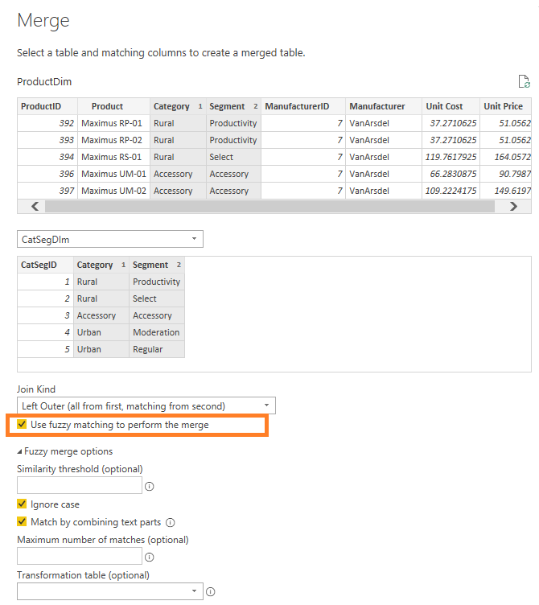
Fuzzy Merge
Fuzzy Merge allows you to apply Fuzzy Matching algorithms when comparing columns and try to find matches across tables being merged.
© 2021 Microsoft All rights reserved.

Slide 75
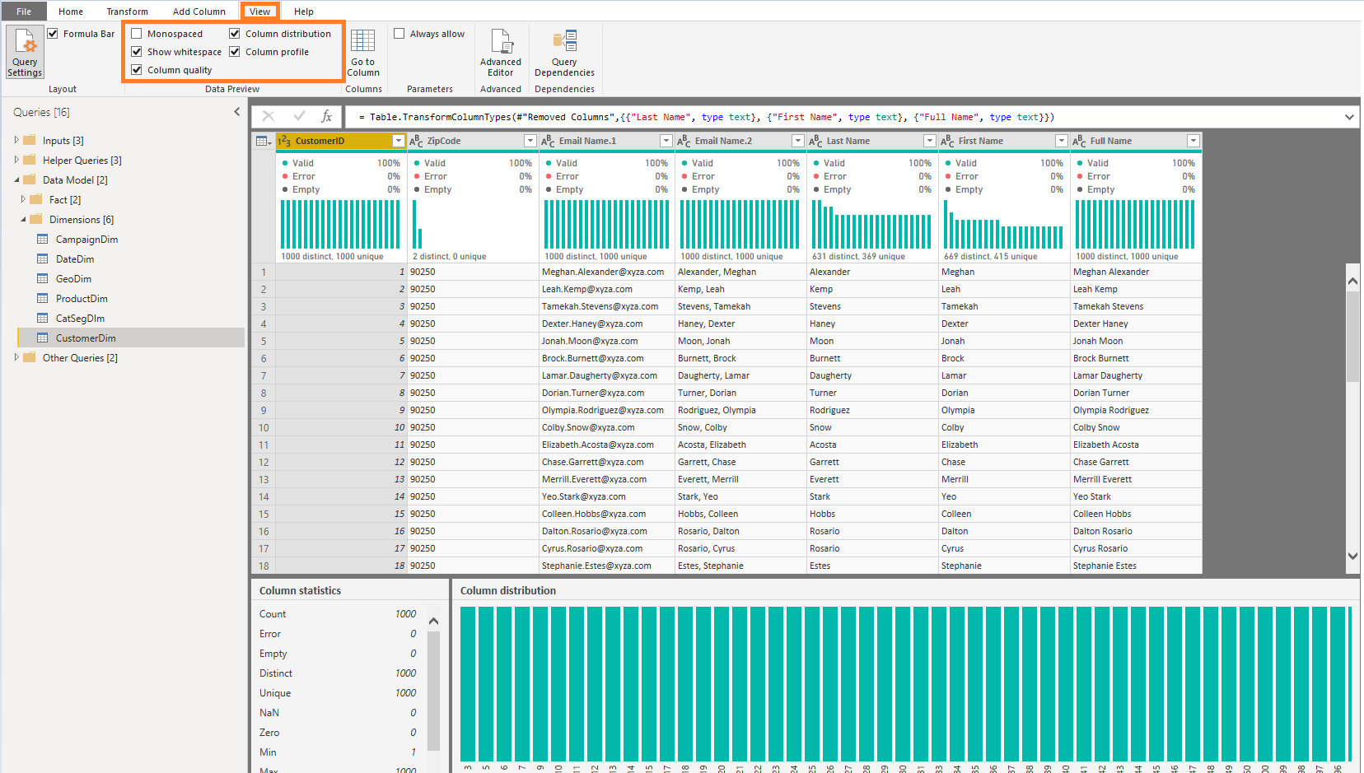
Data Profiling
Data Profiling allows you easily and quickly understand data distribution
Column statistics – # of errors, empty, valid, duplicated and unique values. Value distribution measures such as Min/Max/Average/Median, etc.
Column distribution – Larger size version of the inline value distribution histograms, also including the ability to keep or remove values, which will generate the corresponding Filter Rows step in your query (“Equals” / “Does Not Equal” filters).
© 2021 Microsoft All rights reserved.

Slide 76
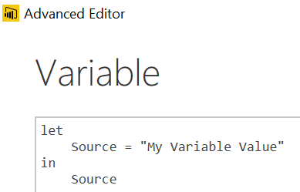
Variables and Parameters
M Variables
Query with a constant value, table or list result
Create with a new blank query
Query name is the Variable name to use in other queries
Type the variable value in the formula bar
Advanced Editor would look like this:
M Parameters
Parameters take Variables to the next level.
Parameters can be any VALID data type
The most common are hard keyed single, switchable values
The values list for a parameter can also come from a query that is formatted as a LIST
Parameter used as Source Input
Parameter Usage
Be Creative!
SQL Server
For Database Name
For Server (Switch Dev, Test, Prod)
“Where Clauses” in SQL Queries
To pull all Orgs, or just a single one
SharePoint Team site names
If they are based on a template, you can easily share queries
File Paths and File Names
Have a single place where you need to make a change
© 2021 Microsoft All rights reserved.

Slide 77
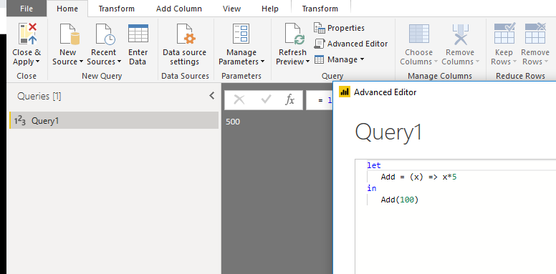
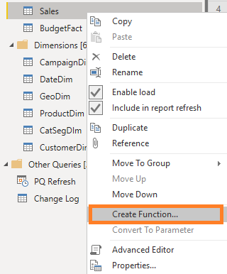
Custom Functions
Custom Functions help you re-use code
Create function using Blank query
Create function using baseline query
© 2021 Microsoft All rights reserved.

Slide 78
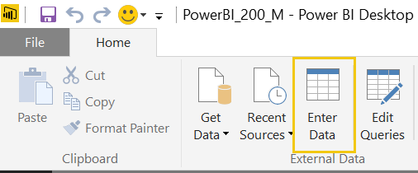


Enter Data
Use Enter Data to add a table on the fly. They make great mapping tables.
<- To add additional rows or columns later, click the gear icon.
© 2021 Microsoft All rights reserved.

Slide 79
Module 4 Lab: Lab 4a – Create dynamic path to Excel Lab 4b – Create dynamic path to CSV Lab 4c – Create custom function

Slide 80
Module 4 Knowledge Check https://aka.ms/PBIModShapCheck4

Slide 81
Module 4 Knowledge Check Questions
What does the Transpose transformation do?
Convert selected rows to column headers
Convert columns to rows, and rows to columns
Convert column headers into values
What does the append query do?
Combines two queries by matching attributes
Stacks records of two queries
Copies a query at a point in time
Which is the best way to add a table on the fly?
Use Enter Data from the ribbon
Write a new SQL statement
Import an additional table
© 2021 Microsoft All rights reserved.

Slide 82
Module 5: Introduction to DAX

Slide 83
Module 5 Objectives
Get introduced to DAX and how can it be used
Understand working with parameters and DAX (lab combining the previous module)
© 2021 Microsoft All rights reserved.

Slide 84



What is a Default Summarization?
Default Summarization
On the Modeling ribbon
For an individual visualization
Create Sales amount units by Category
Sales Amount is automatically summed for each category
You should set this summarization for all numeric fields in the Modeling ribbon
© 2021 Microsoft All rights reserved.

Slide 85
DAX Level Set
DAX: the programming language for the Power BI model engine
DAX looks similar to Excel functions but they have key differences
DAX is very deep and elegant
This class provides a solid base in DAX, but don’t expect to leave being able to write the most complex DAX patterns--they take practice.
Easy to learn, hard to master
© 2021 Microsoft All rights reserved.

Slide 86
Some things you need to know
Calculated columns vs Measures
Evaluation contexts
CALCULATE and iterators
… it gets easier from here…
© 2021 Microsoft All rights reserved.

Slide 87
Path to DAX Expertise
DAX Foundations
Evaluation Contexts
CALCULATE
Calculated Columns and Measures
© 2021 Microsoft All rights reserved.

Slide 88
DAX Foundations
Calculated Column
Measure
© 2021 Microsoft All rights reserved.

Slide 89

What is a Calculated Column
Calculated Column
Pro Tip: Always refer to a calculated column by its full name -> TableName[ColumnName]
© 2021 Microsoft All rights reserved.

Slide 90

Calculated column in DAX
Calculated Column
Custom column in “Query Editor”
Note: If given a choice, creating the column in “M” or “Query Editor” will give you better compression.
Major difference: you cannot refer to other tables / columns in “M”, while you can in DAX.
© 2021 Microsoft All rights reserved.

Slide 91

Calculated Column – Accessing columns from other Tables in model
Calculated Column
Often you want to access columns from multiple tables to create calculated columns
Let’s say you want to calculate COGS, which is Units * Units Cost
Units Cost is in another Table
You cannot do this in M – you need to do this in DAX
© 2021 Microsoft All rights reserved.

Slide 92
When is a Calculated Column Evaluated?
DAX Foundations
“Get Data” Phase
Model Creation Phase
Model
Enhancement
Phase
Visual
Building Phase
Create Query in “M”
Compress data
Auto detect relationships
Add calculated columns, measures
Add missing relationships
Evaluate measures and build each visual
© 2021 Microsoft All rights reserved.

Slide 93
DAX Foundations
Calculated Column
Measure
© 2021 Microsoft All rights reserved.

Slide 94
Demo 5 Measures

Slide 95

What is a Measure?
Measures
[Total Sales]=SUM(Sales[Sales Amount])
Measures are created using DAX
Place your Measures in a Fact table for best results
Pro Tip: When referring to a measure in other calculations, refer to it without a Table name: [MeasureName]
© 2021 Microsoft All rights reserved.

Slide 96
Using One Measure in Another
Measures: Stacking
Instead of writing this:
[Profit] = SUM(Sales[Sales Amount])-SUM(Sales[COGS])
Write this:
[Profit] = [Total Sales]- [Total COGS]
Allows re-use of measures
Formulas are much simpler to read
Careful with potential context switches
© 2021 Microsoft All rights reserved.

Slide 97
More Complex Calculations
Measures: DIVIDE
[Profit Margin %] = [Profit] / [Total Sales]
Ratios are calculations that cannot be created using a calculated column or default summarization
Use DAX DIVIDE for built in error handling
[Profit Margin %] = DIVIDE([Profit] , [Total Sales])
© 2021 Microsoft All rights reserved.

Slide 98
More Complex Calculations Using Variables
Measures: Variables
MobileSalesLastYear =
VAR MobileProducts = FILTER(
ALL('CampaignDim'[Device]),
CampaignDim[Device]="Mobile"
)
VAR LastYear = SAMEPERIODLASTYEAR('DateDim'[Date])
RETURN
CALCULATE(SUM(Sales[Sales Amount]),MobileProducts,LastYear)
Allows re-use of variables
Formulas are much simpler to read
© 2021 Microsoft All rights reserved.

Slide 99

Calculated Column vs. Measure - When to use what
Calculated Column vs Measure
Columns
Values
Slicer
Rows
Rule of Thumb for Calculated Column vs Measure
Calculated Column – Use in Page, Report & Visual Filters as well as Slicers, Rows and Columns
Measures - Use in Values section
© 2021 Microsoft All rights reserved.

Slide 100



Quick Measures are wizard-driven DAX calculations
Quick Measures
Right click a table and select Quick Measures
Select calculation type and fill-in parameters
DAX is generated automatically
Great way to learn DAX
See Quick Measure gallery: https://community.powerbi.com/t5/Quick-Measures-Gallery/bd-p/QuickMeasuresGallery
© 2021 Microsoft All rights reserved.

Slide 101
Some things you need to know
Calculated Columns vs Measures
Evaluation contexts
CALCULATE and iterators
… it gets easier from here…
© 2021 Microsoft All rights reserved.

Slide 102
PATH to DAX Expertise
DAX Foundations
Evaluation Contexts
CALCULATE
Calculated Columns and Measures
© 2021 Microsoft All rights reserved.

Slide 103
Evaluation Context
There are two contexts under which calculations are evaluated
Row Context
When you add a column to a table, the row context lets a single row’s calculation look at other values in the same row.
Filter Context
When you “ask for a table”, the filter context is the set of filters that gets applied before the table is handed over to you.
© 2021 Microsoft All rights reserved.

Slide 104

Row Context in Calculated Column
Formula is evaluated row by row
The context under which formula is evaluated for each row is called “Row Context”
© 2021 Microsoft All rights reserved.

Slide 105

Filter Contexts in Measures
Filter Context in a Measure – Example 1
[Total Sales] = SUM(Sales[Sales Amount])
Filter Context for current coordinate:
Formula is evaluated for each “Coordinate” in each visual
The context for each coordinate is called “Filter Context”
© 2021 Microsoft All rights reserved.

Slide 106


Filter Context in a Measure – Example 2
Filter Contexts in Measures
[Total Sales] = SUM(Sales[Sales Amount])
Filter Context : Year = 2015, Quarter = Q1
Filter Context : Year = 2015, Quarter = Q2
© 2021 Microsoft All rights reserved.

Slide 107
Filter Context in a Measure
Filter Contexts in Measures
[Total Sales] = SUM(Sales[Sales Amount])
Better definition of above measure:
“Total Sales” = Sum of Sales[Sales Amount] column under a filter context
© 2021 Microsoft All rights reserved.

Slide 108


Filter Context and Multiple Tables
Filter context automatically propagates through relationships, in the direction of the relationship (or both when using a bi-directional relationship)
Filtering the DateDim Table to Year = 2015 returns only Sales for 2015
© 2021 Microsoft All rights reserved.

Slide 109

Filter Context and Multiple Tables
Filter Context and Multiple Tables
Filters (Filter context) automatically propagates based on direction of arrows in relationships
Examples
Filter goes from DateDim to CustomerDim
Filter does not go from CustomerDim to DateDim
© 2021 Microsoft All rights reserved.

Slide 110

Filter Context and Multiple Tables
Filter Context and Multiple Tables
Cross filtering works properly
Filter goes from DateDim to CustomerDim enabling the cross filtering
© 2021 Microsoft All rights reserved.

Slide 111

Filter Context and Multiple Tables – Wrong Arrow Direction
Filter Context and Multiple Tables
Cross filtering does not work
Filter goes from DateDim to CustomerDim - the Count of Month in the table above is incorrect – same value repeated over and over again
© 2021 Microsoft All rights reserved.

Slide 112
Detailed example of row and filter context
Sales
Our visual:
USA Sales :=
CALCULATE(
SUMX(
Sales,
Sales[Amount] * 0.90
),
Customer[Country] = “USA”
)
Name | Amount
YA | 6
AL | 8
JE | 9
AL | 8
FR | 6
USA Sales
19.8
Customer
Steps:
Add USA to the filter context
Go get a view of the Sales table in the current filter context (which now includes USA)
Expansion happens here
Send this new view into the SUMX function to be evaluated
Add a column “X” to this new view using the formula from argument 2 of SUM(X) (for each row, get the amount and multiply it by 0.90)
Sum up column “X” and return
Name | Country
YA | USA
JE | The Netherlands
AL | USA
FR | Germany
© 2021 Microsoft All rights reserved.

Slide 113
Step 1: Add USA to the filter context
Sales
Filter context:
Customer[Country] = “USA”
Name | Amount
YA | 6
AL | 8
JE | 9
AL | 8
FR | 6
Customer
*
Name | Country
YA | USA
JE | The Netherlands
AL | USA
FR | Germany
© 2021 Microsoft All rights reserved.

Slide 114
Step 2: Get a view of the Sales table in the current filter context (1/2)
Sales
Filter context:
Customer[Country] = “USA”
Name | Amount
YA | 6
AL | 8
JE | 9
AL | 8
FR | 6
Expanded table
Sales[Name] | Sales[Amount] | Customer[name] | Customer[Country]
YA | 6 | YA | USA
AL | 8 | AL | USA
JE | 9 | JE | The Netherlands
AL | 8 | AL | USA
FR | 6 | FR | Germany
Customer
*
1
Name | Country
YA | USA
JE | The Netherlands
AL | USA
FR | Germany
© 2021 Microsoft All rights reserved.

Slide 115
Step 2: Get a view of the Sales table in the current filter context (2/2)
Sales
Filter context:
Customer[Country] = “USA”
Name | Amount
YA | 6
AL | 8
JE | 9
AL | 8
FR | 6
Expanded table (after application of filter context)
Sales[Name] | Sales[Amount] | Customer[name] | Customer[Country]
YA | 6 | YA | USA
AL | 8 | AL | USA
AL | 8 | AL | USA
Customer
*
1
Name | Country
YA | USA
JE | The Netherlands
AL | USA
FR | Germany
Step 3: Send this expanded table into the SUMX function to be evaluated
© 2021 Microsoft All rights reserved.

Slide 116
Step 4: Add column X
Sales
Filter context:
Customer[Country] = “USA”
Name | Amount
YA | 6
AL | 8
JE | 9
AL | 8
FR | 6
Expanded table (after application of filter context)
Sales[Name] | Sales[Amount] | Customer[name] | Customer[Country] | “X”
YA | 6 | YA | USA
AL | 8 | AL | USA
AL | 8 | AL | USA
5.4
7.2
7.2
Customer
*
1
Name | Country
YA | USA
JE | The Netherlands
AL | USA
FR | Germany
Row context
© 2021 Microsoft All rights reserved.

Slide 117
Step 5: Sum up column “X” and return
Sales
Filter context:
Customer[Country] = “USA”
Name | Amount
YA | 6
AL | 8
JE | 9
AL | 8
FR | 6
Expanded table (after application of filter context)
Sales[Name] | Sales[Amount] | Customer[name] | Customer[Country] | “X”
YA | 6 | YA | USA
AL | 8 | AL | USA
AL | 8 | AL | USA
5.4
7.2
7.2
Customer
*
1
Name | Country
YA | USA
JE | The Netherlands
AL | USA
FR | Germany
5.4+7.2+7.2=19.8
Our visual:
USA Sales
19.8
© 2021 Microsoft All rights reserved.

Slide 118
Evaluation context: summary
Row Context
When you add a column to a table, the row context lets a single row’s calculation look at other values in the same row.
Filter Context
When you “ask for a table”, the filter context is the set of filters that gets applied before the table is handed over to you.
Does not propagate automatically
If you want to propagate this, use RELATED or RELATEDTABLE
Propagates automatically if allowed by direction of relationship
© 2021 Microsoft All rights reserved.

Slide 119
DAX Function Types
Scalar Functions
Table Functions
Scalar functions return a Single value as an output
Ex. SUM(Sale[Sales Amount])
Table functions return a Table as an output
Ex. ALL(GeographyDim)
There are other ways to classify functions – By kind of operation they perform etc.
© 2021 Microsoft All rights reserved.

Slide 120
Applications of Table Functions
Table functions can be used two ways in Power BI Desktop
As an input to another DAX function
CALCULATE
Iterator functions (SUMX, AVERAGEX)
Calculated Tables
© 2021 Microsoft All rights reserved.

Slide 121
Basic TABLE Functions
Return All Rows
Return Distinct Rows
Return Filtered Rows
ALL & variants
ALL, DISTINCT, VALUES
FILTER
There are more advanced Table functions, which we will not cover
© 2021 Microsoft All rights reserved.

Slide 122
Basic TABLE Functions – Return All Rows
The ALL function - Can take either a table or columns in a table as input
ALL with Entire Table
ALL with One Column
ALL with Multiple Columns
ALL(GeographyDim)
ALL(GeographyDim[Region]))
ALL(GeographyDim[Region],
GeographyDim[State])
Returns all rows all columns in table
Returns all unique values of column
Returns all unique combinations of column values
© 2021 Microsoft All rights reserved.

Slide 123
Basic TABLE Functions – ALL Versions
There are several forms of the ALL function
ALL
ALLEXCEPT - Return all columns in a table except 1 or more columns
ALLSELECTED - Return all values in a column selected by users in slicers
ALLNONBLANKROW - Return all non-blank rows
© 2021 Microsoft All rights reserved.

Slide 124
Basic TABLE Functions – Return Distinct Rows
VALUES – Return all distinct values in a column or table
(including blank rows)
DISTINCT - Return all distinct values in a column or table
(not including blank rows)
© 2021 Microsoft All rights reserved.

Slide 125
Basic TABLE Functions – Return Distinct Value
HASONEVALUE - Returns TRUE when the context for columnName has been filtered down to one distinct value only. Otherwise returns FALSE
Header = IF (
HASONEVALUE (
ProductDim[Price Band] ),
CONCATENATE (“Report Header for Price Band : ",
VALUES ( ProductDim[Price Band] )
),
"Overall Report")
© 2021 Microsoft All rights reserved.

Slide 126
Basic TABLE Functions – Return Distinct Value
SELECTEDVALUE - Returns the value when the context for columnName has been filtered down to one distinct value only. Otherwise returns alternateResult.
Header =
VAR selectedPriceBand =SELECTEDVALUE ( ProductDim[Price Band] )
RETURN IF (
ISBLANK ( selectedPriceBand ),
"Overall Report",
CONCATENATE ( "Report Header for Price Band: ", selectedPriceBand
)
)
© 2021 Microsoft All rights reserved.

Slide 127

Basic TABLE Functions – Return Filtered Set of Rows
FILTER(ALL(GeographyDim[Region], GeographyDim[State]), GeographyDim[Region] = “East”)
Take all unique combinations of GeographyDim[Region], GeographyDim[State]
Filter down to the rows where GeographyDim[Region] = “East”
© 2021 Microsoft All rights reserved.

Slide 128

RELATED Function
Follow a chain of relationship from Many-side to One-side using RELATED
SalesFact[City State]= RELATED(GeoDim[City]) & ", " & RELATED(GeoDim[State])
Meaningful names: Geo dim is Geography Dimension
In your data model please call the table Geography and Sales
© 2021 Microsoft All rights reserved.

Slide 129
RELATEDTABLE Function
Shortcut for CALCULATETABLE function with no logical expression
The data is filtered in new context
Function is not supported in the DirectQuery mode
SUMX (RELATEDTABLE(‘Sales’), [Sales Amount])
© 2021 Microsoft All rights reserved.

Slide 130
When is a Measure Evaluated?
DAX Foundations
“Get Data” Phase
Model Creation Phase
Model
Enhancement
Phase
Visual
Building Phase
Create Query in “M”
Compress data
auto detect relationships
Add calculated columns, Measures
Add missing relationships
Evaluate Measures and build each visual
© 2021 Microsoft All rights reserved.

Slide 131
Module 5 Lab: Lab 5 – Create new measures & columns

Slide 132
Knowledge Check Module 5 https://aka.ms/PBIModShapCheck5

Slide 133
Module 5 Knowledge Check Questions
What is one benefit to using DAX instead of M
It is faster
You can refer to other tables
It is easier to read
When would you use a measure instead of a calculated column?
When you want to aggregate values
When you want to create values for every row
Copies a query at a point in time
For best results what table should you put your measures in?
Date table
Fact table
Dimension table
© 2021 Microsoft All rights reserved.

Slide 134
Module 6: Working with Functions: DAX, CALCULATE, Custom Functions

Slide 135
Module 6 Objectives
Understand working with functions
Understand the basics of the CALCULATE formula
© 2021 Microsoft All rights reserved.

Slide 136
Some things you need to know
Calculated columns vs Measures
Evaluation contexts
CALCULATE and iterators
… it gets easier from here…
© 2021 Microsoft All rights reserved.

Slide 137
PATH to DAX Expertise
DAX Foundations
Evaluation Contexts
CALCULATE
Calculated Columns and Measures
© 2021 Microsoft All rights reserved.

Slide 138


Why is CALCULATE Useful?
CALCULATE
You create a report of breakdown of Sales by Month
Typical Business Question:
Provide a breakout of Sales from Desktop
© 2021 Microsoft All rights reserved.

Slide 139
Here is how you do it with CALCULATE
CALCULATE
[Desktop Sales] = CALCULATE([Total Sales], CampaignDim[Device] = "Desktop")
Use CALCULATE function to create a measure which filters down to Desktop Sales
© 2021 Microsoft All rights reserved.

Slide 140
Anatomy of CALCULATE
CALCULATE
CALCULATE(Expression, [Filter 1], [Filter 2]…..)
Filter Arguments
EXPRESSION used as the first parameter is essentially the same as a measure
CALCULATE works differently from other DAX functions:
The second set of arguments, i.e. the “Filter arguments,” are evaluated and applied first
Then the Expression is evaluated under new “Filter Context"
© 2021 Microsoft All rights reserved.

Slide 141
Demo 6A CALCULATE function

Slide 142
CALCULATE – The Most Important Function in DAX
CALCULATE – Add Filter
Key things that CALCULATE can do:
Add Filter
Ignore Filter
Update Filter
Convert Row Context to Filter Context
(context transition)
In other words, it can modify the filter context and then calculate a number under the new filter context
© 2021 Microsoft All rights reserved.

Slide 143

CALCULATE – Add Filter
[Desktop Sales] = CALCULATE([Total Sales], CampaignDim[Device] = "Desktop")
[Tablet Sales] = CALCULATE([Total Sales], CampaignDim[Device] = “Tablet")
[Mobile Sales] = CALCULATE([Total Sales], CampaignDim[Device] = “Mobile")
When the Device Slicer is selected, only “Total Sales” changes.
© 2021 Microsoft All rights reserved.

Slide 144
CALCULATE – The Most Important Function in DAX
CALCULATE – Ignore Filter
Key things that CALCULATE can do
Add Filter
Ignore Filter
Update Filter
Convert Row Context to Filter Context
(context transition)
© 2021 Microsoft All rights reserved.

Slide 145


CALCULATE – Ignore an existing filter
[Total Sales All Geo] = CALCULATE([Total Sales], ALL(GeographyDim))
Ignores filter on ANY column from the GeographyDim table, but allows filters from Year
© 2021 Microsoft All rights reserved.

Slide 146


CALCULATE – Ignore an existing filter
[Total Sales All States] = CALCULATE([Total Sales], ALL(GeographyDim[State]))
Ignores filter on the State column from the GeographyDim table, but allows filters from Year
© 2021 Microsoft All rights reserved.

Slide 147


CALCULATE – Ignore an existing filter
[Total Sales All Selected States] = CALCULATE([Total Sales], ALLSELECTED(GeographyDim[State]))
Ignores filter on the State column from the GeographyDim table, but allows filters from Year
© 2021 Microsoft All rights reserved.

Slide 148
CALCULATE – The Most Important Function in DAX
CALCULATE – Update Filter
Key things that CALCULATE can do
Add Filter
Ignore Filter
Update Filter
Convert Row Context to Filter Context (context transition)
© 2021 Microsoft All rights reserved.

Slide 149


CALCULATE – Update Existing Filter
[2014 Sales] = CALCULATE([Total Sales], DateDim[Year] = 2014)
Ignores filter on the Year slicer
© 2021 Microsoft All rights reserved.

Slide 150
CALCULATE – The Most Important Function in DAX
CALCULATE – Context transition
Key things that CALCULATE can do
Add Filter
Ignore Filter
Update Filter
Convert Row Context to Filter Context (context transition)
© 2021 Microsoft All rights reserved.

Slide 151


Context Transition
Sales
Let’s add a measure:
Sum as measure = SUM( Sales[Amount] )
Name | Amount
YA | 6
AL | 8
JE | 9
AL | 8
FR | 6
Add as new visual. What is the result?
Add Customer[Country] to that visual. What is the result?
Customer
*
1
In each row,
each country is acting as a filter for that row.
Essentially saying:
SUM( Sales[Amount])
where country = “Germany”, etc.
Name | Country
YA | USA
JE | The Netherlands
AL | USA
FR | Germany
© 2021 Microsoft All rights reserved.

Slide 152

Context Transition
Sales
Let’s add a calculated column:
Sum as column = SUM( Sales[Amount] )
Name | Amount
YA | 6
AL | 8
JE | 9
AL | 8
FR | 6
What is the result?
Customer
*
1
Name | Country
YA | USA
JE | The Netherlands
AL | USA
FR | Germany
There are no filters on each row when this is executed,
so you get the total on each row
© 2021 Microsoft All rights reserved.

Slide 153

Context Transition
Sales
Let’s add another calculated column, using CALCULATE:
Sum as column2 = CALCULATE(SUM(Sales[Amount]))
Name | Amount
YA | 6
AL | 8
JE | 9
AL | 8
FR | 6
What is the result?
Customer
*
1
Name | Country
YA | USA
JE | The Netherlands
AL | USA
FR | Germany
Why? CALCULATE uses context transition
(CALCULATETABLE does the same).
© 2021 Microsoft All rights reserved.

Slide 154
Context Transition
Sales
In a context transition, CALCULATE takes the columns in the row (row context) it is not operating on and adds it as a filter context. So:
Name | Amount
YA | 6
AL | 8
JE | 9
AL | 8
FR | 6
Name | Amount | Sum as column 2
YA | 6
AL | 8
JE | 9
AL | 8
FR | 6
6
16
9
16
6
Customer
*
1
Name | Country
YA | USA
JE | The Netherlands
AL | USA
FR | Germany
Row context
Filter context:
Sales[Name] = “YA”
This is context transition.
© 2021 Microsoft All rights reserved.

Slide 155
DAX Iterator Functions Take Advantage of Evaluation Context
DAX Iterator Functions
Iterator Functions
Creates a row context by iterating over a table that you specify
Ex. SUMX: takes a table, adds a column to it, then sums up that column.
© 2021 Microsoft All rights reserved.

Slide 156
Table Functions Application - Iterators
[COGS] = SUMX(Sales, Sales[Units] * RELATED(ProductDim[Unit Cost]))
Argument 1
Argument 2
© 2021 Microsoft All rights reserved.

Slide 157

Table Functions Application - Iterators
[COGS] = SUMX(Sales, Sales[Units] * RELATED(ProductDim[Unit Cost]))
Argument 1
Iterate through each row in Argument 1
Sales
© 2021 Microsoft All rights reserved.

Slide 158


Table Functions Application - Iterators
[COGS] = SUMX(Sales, Sales[Units] * RELATED(ProductDim[Unit Cost]))
Argument 2
Sales
ProductDim
© 2021 Microsoft All rights reserved.

Slide 159

Row Context in a Measure – Iterator Functions
[COGS] = SUMX(Sales, Sales[Units] * RELATED(ProductDim[Unit Cost]))
SUM it up
SUM up list obtained
© 2021 Microsoft All rights reserved.

Slide 160
Why Can an iterator be a better approach then a calculated column?
Iterators
You avoid creating a calculated column
Imagine the impact of a calculated column called COGS on a data model with 100K rows - What if we have 10 M rows?
Iterators help you avoid several “Intermediate Calculated Columns”
© 2021 Microsoft All rights reserved.

Slide 161
CALCULATE – Converting Row Context to Filter Context (Example 1)
DAX Foundations
Sales Velocity = IF(
SUMX(RELATEDTABLE(Sales), Sales[Sales Amount])>=200000,
“High Velocity”,
“Low Velocity”)
Sales Velocity = IF (
CALCULATE(SUM(Sales[Sales Amount])) >= 200000,
"High Velocity",
"Low Velocity")
Another way to do Dynamic Segmentation
This method does not use iterators
Instead, use CALCULATE to convert row context to filter context
© 2021 Microsoft All rights reserved.

Slide 162
Other Iterator Functions
AVERAGEX , PRODUCTX, MINX, MAXX– All work the same way as SUMX
RANKX – Works like SUMX, but slightly more complex (more options)
© 2021 Microsoft All rights reserved.

Slide 163
Table Functions – Summary and Application
Table functions can be used in two ways in Power BI Desktop:
As an input to another DAX function
CALCULATE
Iterator functions
Calculated Tables
CALCULATE is one of the primary places where table functions are used
© 2021 Microsoft All rights reserved.

Slide 164
Demo 6b Calculated Tables

Slide 165
CALCULATE – Steps in Evaluating the CALCULATE Function
CALCULATE
CALCULATE(Expression, [Filter1], [Filter2]…..)
Step 1: Copy the current filter context
Step 2: Add new filters if any (arguments)
Step 3: Update/ignore existing filters if any (arguments)
Step 4: invalidate current row context and convert row context to filter context
Step 5: AND all filter conditions to create new filter context
Step 6: Evaluate the expression
Step 7: Return back to original filter context
© 2021 Microsoft All rights reserved.

Slide 166
Introducing Time Intelligence – There is an App for that!!
Advanced DAX – Time Intelligence
[SalesYTD Easier] =
CALCULATE (
[Total Sales],
DATESYTD(DateDim[Date])
)
This allows you to write the formula without being a DAX guru!
Microsoft is continuously improving Time Intelligence functions to make it simple to use
Time Intelligence functions are your friends – They will save you time!
© 2021 Microsoft All rights reserved.

Slide 167
Advanced DAX – Month over Month
Total Sales Last Month =
CALCULATE([Total Sales],
PREVIOUSMONTH(DateDim[Date]))
MoM =
DIVIDE([Total Sales] - [Total Sales Last Month],
[Total Sales Last Month])
DAX has several shortcut time intelligence functions
© 2021 Microsoft All rights reserved.

Slide 168
Advanced DAX – Monthly Active Users
[Monthly Active Users] =
CALCULATE(
SUMX(VALUES(Sales [CustomerId]),1),
ALL('DateDim'),
DATESINPERIOD('DateDim'[Date],
LASTDATE('DateDim'[Date]), -1, MONTH)
)
SUMX vs DistinctCount of CustomerID
SUMX can be more performant
© 2021 Microsoft All rights reserved.

Slide 169
Other Time Intelligence Functions
Advanced DAX – Time Intelligence
DATESINPERIOD
DATESYTD
DATESQTD
NEXTMONTH NEXTYEAR
PREVIOUSYEAR PREVIOUSMONTH SAMEPERIODLASTYEAR
PARALLELPERIOD
Pro Tip: Learn about time intelligence functions - https://msdn.microsoft.com/en-us/library/ee634763.aspx
© 2021 Microsoft All rights reserved.

Slide 170
Module 6 Lab: Lab 6 – Create a segment-specific report

Slide 171
Knowledge Check Module 6 https://aka.ms/PBIModShapCheck6

Slide 172
Module 6 Knowledge Check Questions
What is considered the most important function in DAX?
RELATED
CALCULATE
SUMX
In what situation should you use an iterator rather than a calculated column?
You have a very large dataset
You want create filter context
You have too many calculated tables
Which is NOT a benefit to using time intelligence functions?
They will save you time
There is a lot of code to write
DAX already has built in functions
© 2021 Microsoft All rights reserved.

Slide 173
Module 7: Modeling with Power BI Best Practices & Optimization Techniques

Slide 174
Module 7 Objectives
Gain familiarity with basic data modeling for business scenarios
Learn some best practices for working with Power BI
© 2021 Microsoft All rights reserved.

Slide 175
Data Modeling
An inefficient model can completely slow down a report, even with very small data volumes
GOALS
Make the model as small as possible
There are valid reasons to bend this rule
Schema supports the analysis
Relationships are built purposefully and thoughtfully
© 2021 Microsoft All rights reserved.

Slide 176
Move Calculation to the Source
Scenario
Many DAX calculated columns with high cardinality
Why is it undesired?
Calculated columns don’t compress as well as physical columns
Proposed Solution
Perform calculations in Power Query, ideally push down
Customize source query for non foldable transforms
© 2021 Microsoft All rights reserved.

Slide 177
Remove Unused Table and Columns
Scenario
Model contains tables/columns that are not used for reporting/analysis or calculations
Why is it undesired?
Increases model size
Increases time to load into memory
Increases refresh time
May affect usability
© 2021 Microsoft All rights reserved.

Slide 178
Avoid High Precision/Cardinality Columns
Scenario
Model contains columns at a higher precision than needed for analysis e.g. datetime in milliseconds, weight to 6 decimal places
Model contains columns that are highly unique
Why is it undesired?
Less compression with high precision/cardinality
Increases time to load into memory
Increases refresh time
Proposed Solution
Remove if not needed
Reduce precision
Split datetime into date and time
© 2021 Microsoft All rights reserved.

Slide 179
Use Integers instead of Strings
Why is it undesired?
Strings use dictionary encoding, integers use run length encoding which is more efficient
Proposed Solution
Check data types and set to integer if known to be numerical
© 2021 Microsoft All rights reserved.

Slide 180
Use Integer Surrogate Keys, Pre-sort them
Power BI compresses rows in segments of millions of rows
Integers use Run Length Encoding
Sorting will maximize compression when encoded as it reduces the range of values per segment
© 2021 Microsoft All rights reserved.

Slide 181

Be Careful with Bi-Directional Relationships
Scenario
Most relationships in the model are set to bi-directional
Why is it undesired?
Applying filters/slicers traverses many relationships and can be slower
Some filter chains unlikely to add business value
Proposed Solution
Only use bi-directional where the scenario requires it
© 2021 Microsoft All rights reserved.

Slide 182

Set Default Summarization
Scenario
Numeric columns in model that are purely informational (e.g. Account ID)
Default summarization is Sum
Why is it undesired?
Power BI will try to sum the number when dropped into visuals.
Detailed tables/matrixes can be slower
Proposed Solution
Set the default summarization to None
© 2021 Microsoft All rights reserved.

Slide 183
Best Practices with DAX Calculated Columns
Best Practices – Calculated Column
Whenever possible, DAX helper columns should be avoided. Each “Helper Column” will consume RAM
Create a calculated column in the Dim Table as opposed to in the Fact Table
Move calculated columns to “M” if you can
© 2021 Microsoft All rights reserved.

Slide 184
Use Variables instead of Repeating Measures
Consider the following DAX expression:
Ratio = IF([Total Rows] > 10, SUM(Revenue) /[Total Rows], 0)
Faster DAX:
VAR totalRows = [Total Rows];
Ratio = IF(totalRows > 10, SUM(Revenue) / totalRows,0)
In the first expression, since measures are calculated on the fly, the [Total Rows] expression gets calculated twice, first for the condition check and then for the true condition expression
Instead of calculating the same expression multiple times, the resulting measure value can be stored in a variable and variable reference can be used wherever required
© 2021 Microsoft All rights reserved.

Slide 185
Use DIVIDE() Instead of /
DIVIDE() function has 3rd extra parameter which is returned in case of denominator being zero
It internally performs check to validate if the denominator is 0
There is no need to use IF condition along with '/' operator to check for invalid denominator
DIVIDE() also checks for ISBLANK()
Note: If it is certain that the denominator value would not be 0, then it is better to use '/' operator without any IF check since DIVIDE() function would always perform an IF check internally
© 2021 Microsoft All rights reserved.

Slide 186
Calculate Ratios Efficiently
Use (a-b)/b with variables instead of a/b – 1 or a/b*100 – 100
We can achieve the same performance by using variables and using (a-b)/b to calculate ratio
If both a and b are blank values, then (a-b)/b would return blank and would be filtered out where as a/b – 1 would return -1 and increase query space
© 2021 Microsoft All rights reserved.

Slide 187
Don’t change blanks to zeros or other values
Sometimes people replace blanks with zeros or other strings
Power BI automatically filters out all the rows with blank values from query results
If the blanks are replaced, the query space is greatly increased
© 2021 Microsoft All rights reserved.

Slide 188
Use SELECTEDVALUE() instead of HASONEVALUE()
A common pattern is to use HASONEVALUE() to check if there is only one value present for a column after applying slicers and filters and then use VALUES(ColumnName) DAX function to get the single value
SELECTEDVALUE() performs both the above steps internally and gets the value if there is only one distinct value present for that column or returns blank in case there are multiple values available
© 2021 Microsoft All rights reserved.

Slide 189
Use SELECTEDVALUE() instead of VALUES()
VALUES() returns error in case it encounters multiple values. Normally, users handle it using error functions which are bad for performance
Instead of using that, SELECTEDVALUE() must be used which is a safer function and returns blank in case of multiple values being encountered
© 2021 Microsoft All rights reserved.

Slide 190
Use DISTINCT() and VALUES() functions consistently
Power BI adds a blank value to the column in case it finds referential integrity violation
For direct query, Power BI by default adds blank value to the columns as it does not have a way to check for violations
Difference :
DISTINCT(): Does not return blank which is added due to integrity violation. It includes blank only if it is part of original data
VALUES(): It includes blank which is added by Power BI due to referential integrity violation
The usage of either of the function should be same throughout the whole report
Power BI recommends to use VALUES() in the whole report if possible and blank value is not an issue
© 2021 Microsoft All rights reserved.

Slide 191
Avoid using IFERROR() and ISERROR()
IFERROR() and ISERROR() are sometimes used in measures
These functions force Power BI engine to perform step by step execution of each row to check for errors as there is currently no way that directly states which row returned the error
FIND() and SEARCH() DAX functions provide an extra parameter which can be passed and is returned in case of the search string not present – avoids use of IFERROR/ISERROR
Both of this functions are currently also used to check for divide by zero error or along with values to check if more than one values are returned.
Can be avoided by using the correct DAX functions like DIVIDE() and SELECTEDVALUE() which performs the error check internally and returns the expected results
© 2021 Microsoft All rights reserved.

Slide 192
Use ISBLANK() instead of =BLANK() check
Use inbuilt function ISBLANK() to check for any blank values instead of using comparison operator “= Blank()”
ISBLANK() is faster
© 2021 Microsoft All rights reserved.

Slide 193
Use FILTER(ALL(ColumnName))
To calculate measures ignoring all the filters applied on a column, use All(ColumnName) function along with the FILTER instead of Table or VALUES(). Eg: CALCULATE([Total Sales], FILTER(ALL(Products[Color]), Color = 'Red’))
Directly applying filters using expressions and not using FILTER function behaves in the same way as mentioned above and it internally translates to use ALL function in the filter
Eg: CALCULATE([Total Sales], Products[Color]= 'Red’)) ->
CALCULATE([Total Sales], FILTER(ALL(Products[Color]), Products[Color]= 'Red’)
It is always better to apply filters at desired column than the whole table
Always use ALL along with FILTER function if there is no specific need to keep current context
https://pbidax.wordpress.com/2016/05/22/simple-filter-in-dax-measures/
https://www.sqlbi.com/articles/filter-arguments-in-calculate/
© 2021 Microsoft All rights reserved.

Slide 194
Do not use scalar variables in SUMMARIZE()
SUMMARIZE() traditionally used to perform grouping of columns and get the resulting aggregations along with it
It is recommended to use SUMMARIZECOLUMNS() function which is a newer more optimized version
SUMMARIZE function should only be used to get just the grouped elements of a table without any measures/aggregations associated with it.
E.g. SUMMARIZE(Table, Column1, Column2)
© 2021 Microsoft All rights reserved.

Slide 195
Avoid using ADDCOLUMNS() in measure expressions
Measures are calculated in iterative manner by default
If measure definitions use iterative functions like AddColumns, it create nested iteration which downgrades the performance
© 2021 Microsoft All rights reserved.

Slide 196
Avoid string manipulation in measures
Slows down measures
Work is done in calculation engine
© 2021 Microsoft All rights reserved.

Slide 197
Consider Subsets for very large models
Scenario
Large model – hundreds of tables and tens of GB
Large high grain fact tables – millions to billions
Why is it undesired?
Aggregating/measures across large facts can affect performance
Large models become harder to maintain and use ad-hoc
Proposed Solution
Consider aggregations and composite models features
Build manual summary tables with smart measures
Create smaller models for the most common business cases
© 2021 Microsoft All rights reserved.

Slide 198
Key takeaways to design a good Power BI Desktop data model
Designing Good Data Models
RAM is precious !
Save RAM and increase the model’s speed
If a fact table contains an ID field which is unique for each record, remove it
Ex. Transaction ID
Sort columns before bringing them into a Power BI data model
The DateTime data type is usually not needed, unless you are specifically using the Time component
f you really need Time, try splitting Date & Time into two columns - Reduces # of unique values
Star Schema – Good for most Data Models
Power BI Query Diagnostics in Power BI Desktop (Preview)
© 2021 Microsoft All rights reserved.

Slide 199

Performance Analyzer
Using Performance Analyzer:
You will know how each of your report elements, such as visuals and DAX formulas, are performing
You can see and record logs that measure how each of your report elements performs when users interact with them, and which aspects of their performance are most (or least) resource intensive
© 2021 Microsoft All rights reserved.

Slide 200
Module 7 Lab:
Lab 7a – Performance best practices
Lab 7b – Using performance analyzer

Slide 201
Knowledge Check Module 7 https://aka.ms/PBIModShapCheck7

Slide 202
Module 7 Knowledge Check Questions
Which is NOT a data modeling best practice?
Schema supports analysis
The model is unnecessarily large
Relationships are purposeful
Why should you remove unused tables from the model?
They increase the load on the memory
They don’t take up that much space
They’re not bothering anyone!
Why should you avoid string manipulation in measures?
It slows down measures
The code is complex
It is easier to read
© 2021 Microsoft All rights reserved.

Slide 203
Module 8: Are we there yet? Summary Lab and Surveys

Slide 204
Your opinion is important please fill our survey, it allows us to maintain the content https://aka.ms/PBIModShapS

Slide 205
Power BI Support Resources
Contact Support - Report Errors, Issues – Support.PowerBI.com
Resources use presentation mode to click the hyperlinks
Community.PowerBI.com – Community Forum
Data Stories Gallery – Get inspired with Data Stories by other Power BI users
R-Visuals Gallery – Get inspired by others use of R for analyzing their data
Visuals.PowerBI.com – Custom PBI visuals and R visuals you can download and use in your story
Power BI Blog - weekly updates
User Voice for Power BI – Vote on (or submit) your favorite new ideas for Power BI
Issues.PowerBI.Com – log issues with the community
Guided Learning Self Service Power BI training DAX Formula Language – syntax for DAX
DAX Patterns – Great website to learn new patterns for the DAX Language
Power Query Formula Language – syntax for the “Query” language
© 2021 Microsoft All rights reserved.

Slide 206
Power BI Data Modeling in a Day
QUESTIONS?

Slide 207
Power BI Data Modeling in a Day
APPENDIX 1
Knowledge Check Answers

Slide 208
Module 2 Knowledge Check Answers
What is one of the advantages to using a star schema?
You will lower the amount of memory needed
All attributes exist in a single table
It is highly inefficient
Why is it important to have a good data model?
Improves understandability of the data
Decreases resilience to change
Processes may take longer
What table should measures exist in?
Dimension table
Fact table
Date table
© 2021 Microsoft All rights reserved.

Slide 209
Module 3 Knowledge Check Answers
What is M used for?
To create dimension attributes
To build queries that mashup data
To separate facts and dimensions
Which way can you NOT use M?
Custom code
Using the ribbon
Importing a table
What is one rule of using M?
The code must be in bold
It is case sensitive
You cannot use if then else statements
© 2021 Microsoft All rights reserved.

Slide 210
Module 4 Knowledge Check Answers
What does the Transpose transformation do?
Convert selected rows to column headers
Convert columns to rows, and rows to columns
Convert column headers into values
What does the append query do?
Combines two queries by matching attributes
Stacks records of two queries
Copies a query at a point in time
Which is the best way to add a table on the fly?
Use Enter Data from the ribbon
Write a new SQL statement
Import an additional table
© 2021 Microsoft All rights reserved.

Slide 211
Module 5 Knowledge Check Answers
What is one benefit to using DAX instead of M
It is faster
You can refer to other tables
It is easier to read
When would you use a measure instead of a calculated column?
When you want to aggregate values
When you want to create values for every row
Copies a query at a point in time
For best results what table should you put your measures in?
Date table
Fact table
Dimension table
© 2021 Microsoft All rights reserved.

Slide 212
Module 6 Knowledge Check Answers
What is considered the most important function in DAX?
RELATED
CALCULATE
SUMX
In what situation should you use an iterator rather than a calculated column?
You have a very large dataset
You want create filter context
You have too many calculated tables
Which is NOT a benefit to using time intelligence functions?
They will save you time
There is a lot of code to write
DAX already has built in functions
© 2021 Microsoft All rights reserved.

Slide 213
Module 7 Knowledge Check Answers
Which is NOT a data modeling best practice?
Schema supports analysis
The model is unnecessarily large
Relationships are purposeful
Why should you remove unused tables from the model?
They increase the load on the memory
They don’t take up that much space
They’re not bothering anyone!
Why should you avoid string manipulation in measures?
It slows down measures
The code is complex
It is easier to read
© 2021 Microsoft All rights reserved.

Slide 214
Power BI Data Modeling in a Day
APPENDIX 2
Power BI Compressing Data Mechanism

Slide 215
Aggregations
Using aggregations in Power BI enables interactive analysis over big data. Advantages of aggregation are:
Query performance over big data
Data refresh optimization
Achieve balanced architectures
© 2021 Microsoft All rights reserved.

Slide 216
How Power BI Compresses Data – Dictionary Encoding
Compressing Data – Dictionary Encoding
Sale Id | Color | Sales Amount
390a30e0-dc37 | Red | $10
390a30e1-dc37 | Green | $25
390a30e2-dc37 | Red | $35
390a30e3-dc37 | Red | $15
390a30e4-dc37 | Red | $25
390a30e5-dc37 | Green | $30
390a30e6-dc37 | Blue | $10
390a30e7-dc37 | Blue | $12
390a30e8-dc37 | Blue | $15
390a57f0-dc37 | Blue | $18
390a57f1-dc37 | Green | $25
Red = 1 Green = 2 Blue = 3
Create a Dictionary to create an integer value for text string
Storing 1,2,3 instead of “Red”, “Green”, “Blue” saves memory
Dictionary encoding is powerful when there are few unique values in a column
Ex. Color column – Good for dictionary encoding
Ex. Sale ID – Bad for dictionary encoding
© 2021 Microsoft All rights reserved.

Slide 217
How Power BI Compresses Data – Run Length Encoding
Compressing Data – Run Length Encoding
Sale Id | Color | Sales Amount
390a30e0-dc37 | Red | $10
390a30e1-dc37 | Green | $25
390a30e2-dc37 | Red | $35
390a30e3-dc37 | Red | $15
390a30e4-dc37 | Red | $25
390a30e5-dc37 | Green | $30
390a30e6-dc37 | Blue | $10
390a30e7-dc37 | Blue | $12
390a30e8-dc37 | Blue | $15
390a57f0-dc37 | Blue | $18
390a57f1-dc37 | Green | $25
1
2
1
1
1
2
3
3
3
3
2
Run Length Encoding in Power BI
Instead of storing - 1, 2, 1, 1, 1, 2, 3, 3, 3, 3, 2
It Stores:
Run length encoding is very powerful when data is sorted well and has few unique values
Where Red = 1 Green = 2 Blue = 3
© 2021 Microsoft All rights reserved.

Slide 218
Practical Example of Compression
Compression
Dashboard in a Day Class Data
DIAD Complete Data Model
Sales Fact | 420.0 MB
Dimensions | 4.4 MB
Int’l Sales | 32.4 MB
Total Data | 456.8 MB
Data Model | 59.4 MB
Almost 8X Compression!!
Queries ONLY – No Data Loaded
Query Metadata | 113 KB
© 2021 Microsoft All rights reserved.

Slide 219
Power BI Data Modeling in a Day
APPENDIX 3
Advanced DAX & Time Intelligence

Slide 220

Before we get to Time Intelligence - Let us apply all of the DAX techniques
Advanced DAX
[SalesYTD] =
CALCULATE (
[Total Sales],
FILTER (
ALL ( DateDim),
DateDim[Year] = MAX ( DateDim[Year] )
&& DateDim[Date] <= MAX(DateDim[Date])
)
)
Let us take a super complicated DAX statement and break it down and understand what it means
© 2021 Microsoft All rights reserved.

Slide 221
Before we get to Time Intelligence - Let us apply all of the DAX techniques
Advanced DAX
[SalesYTD] =
CALCULATE (
[Total Sales],
FILTER (
ALL ( DateDim),
DateDim[Year] = MAX ( DateDim[Year] )
&& DateDim[Date] <= MAX( DateDim[Date] )
)
)
In a CALCULATE statement Filter arguments are evaluated first
The Filter in this case comes from a FILTER function
FILTER function is an iterator
© 2021 Microsoft All rights reserved.

Slide 222
Let us apply all of the data modeling techniques
Advanced DAX
[SalesYTD] =
CALCULATE (
[Total Sales],
FILTER (
ALL ( DateDim),
DateDim[Year] = MAX ( DateDim[Year] )
&& DateDim[Date] <= MAX( DateDim[Date] )
)
)
In a FILTER statement the input Table is evaluated first
ALL statement means take all DateDim
© 2021 Microsoft All rights reserved.

Slide 223
Let us apply all of the data modeling techniques
Advanced DAX
[SalesYTD] =
CALCULATE (
[Total Sales],
FILTER (
ALL ( DateDim),
DateDim[Year] = MAX ( DateDim[Year] )
&& DateDim[Date] <= MAX(DateDim[Date] )
)
)
Iterate through each row in DateDim
Check for condition based on row context and filter context
Pro Tip: if you need to concatenate two conditions with an AND use && for and OR use ||
© 2021 Microsoft All rights reserved.
Pro Tip: if you need to concatenate two conditions with an AND use && for and OR use ||

Slide 224
Let us apply all of data modeling techniques
Advanced DAX
[SalesYTD] =
CALCULATE (
[Total Sales],
FILTER (
ALL ( DateDim),
DateDim[Year] = MAX ( DateDim[Year] )
&& DateDim[Date] <= MAX(DateDim[Date] )
)
)
Now you have a FILTERED list of dates
Use this to update the filter context (since it is in a CALCULATE statement)
© 2021 Microsoft All rights reserved.

Slide 225
Let us apply all of the data modeling techniques
Advanced DAX
[SalesYTD] =
CALCULATE (
[Total Sales],
FILTER (
ALL ( DateDim),
DateDim[Year] = MAX ( DateDim[Year] )
&& DateDim[Date] <= MAX(DateDim[Date] )
)
)
Use updated FILTER context to evaluate ‘Total Sales’
© 2021 Microsoft All rights reserved.

Slide 226

Module 4 Lab – File Source Considerations
All of the queries in our file are dependent on the file being in a specified path
If you move the source file and try to refresh the queries you will receive an error
C:\ to File Share
Different folder location
To SharePoint
To OneDrive
Each query will need to be changed EACH time the file is moved
Creating Parameters with Dynamic Paths resolves this issue
© 2021 Microsoft All rights reserved.

Slide 227

Module 4 Lab – Create Parameters
Create Parameters
Actual File
Budget File
Path
© 2021 Microsoft All rights reserved.

Slide 228


Module 4 Lab – Dynamic Path to Excel Source File
Uses Blank Query
Populate Advanced Editor of query with text from file provided
For each query which uses the Excel source, update the Source (applied step) with the new variable name =Actuals_Path
© 2021 Microsoft All rights reserved.

Slide 229


Module 4 Lab – Dynamic Path to Excel Source File
Use the Actuals_Path query as a variable in other queries
In Advanced Editor, update the Excel source to the new Actuals_Path source.
© 2021 Microsoft All rights reserved.

Slide 230


Module 4 Lab – Dynamic Path to CSV Source File
Follow a similar pattern to make the Budget CSV file dynamic
Uses Blank Query
Populate Advanced Editor of query with text from file provided
For each query which uses the Excel source, update the Source (applied step) with the new variable name =Budget_Path
© 2021 Microsoft All rights reserved.

Slide 231


Module 4 Lab – Custom Function
Create a function to get number of days from start of year
Uses Blank Query
Populate Advanced Editor of query with text from file provided
Invoke the custom function from Sales table. This will provide the number of days from start of year for each transaction
© 2021 Microsoft All rights reserved.

Slide 232


Module 4 Lab – Create a Change Log
Use Enter Data to create a Change Log
Create a table within query to house the change log
Name the query Change Log
Update table each time a change is made to the code
If you decide to load file to data model, then you have the ability to report on current version and last update date
Report
© 2021 Microsoft All rights reserved.

Slide 233
Module 4 Lab – Bonus
Create a MEASURE for Total Units Sold
HINT: The formula will probably use SUM()
Create a CALCULATED COLUMN on the fact table that shows product category and campaign traffic channel combined
Example: Urban, Organic Search
It is fairly easy to see that the CALCULATED COLUMN is working. Create some visuals that allow you to confirm that the Total Units Sold MEASURE is working right
© 2021 Microsoft All rights reserved.

Slide 234
Your opinion is important please fill our survey, it allows us to maintain the content https://aka.ms/PBIModShapS

